Slide 1
Otomo M (2012) PAGES news 20(1): 4
From: IODP (2011) Illuminating Earth’s Past, Present, and Future
www.iodp.org/Science-Plan-for-2013-2023/
Notes:
Scientific Ocean Drilling: Voyage of Discovery beyond 2013
Miyuki Otomo
IODP-Management International Inc., Tokyo, Japan; motomo@iodp.org
Figure 1: International Ocean Discovery Program (IODP) drilling strategy at the poles and tropics to collect records linking climate, ice sheet, and sea level histories on geologic time scales. Red arrows represent warm water flow beneath floating ice, recently recognized as a key factor in accelerating ice loss from West Antarctica. Elements of this figure were adapted from Schoof (2010).

Slide 2
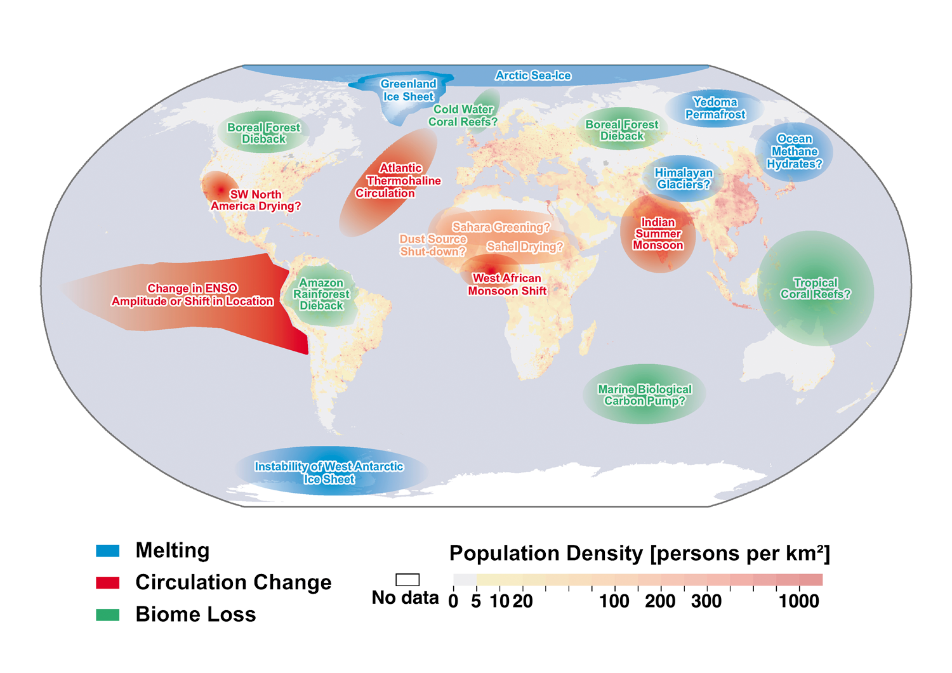
Lenton T (2012) PAGES news 20(1): 8
Updated from Lenton et al. (2008) PNAS 105: 1786-1793
Notes:
Earth System models - How well do Earth system models simulate the dynamics of global change?
Tim Lenton
College of Life and Environmental Sciences, University of Exeter, UK; t.m.lenton@exeter.ac.uk
Figure 1: Map of potential policy-relevant tipping elements in the climate system, categorized into those involving ice melting, circulation changes, or biome losses – updated from Lenton et al. (2008) by Veronika Huber, Martin Wodinski, Tim Lenton and Hans-Joachim Schellnhuber.

Slide 3
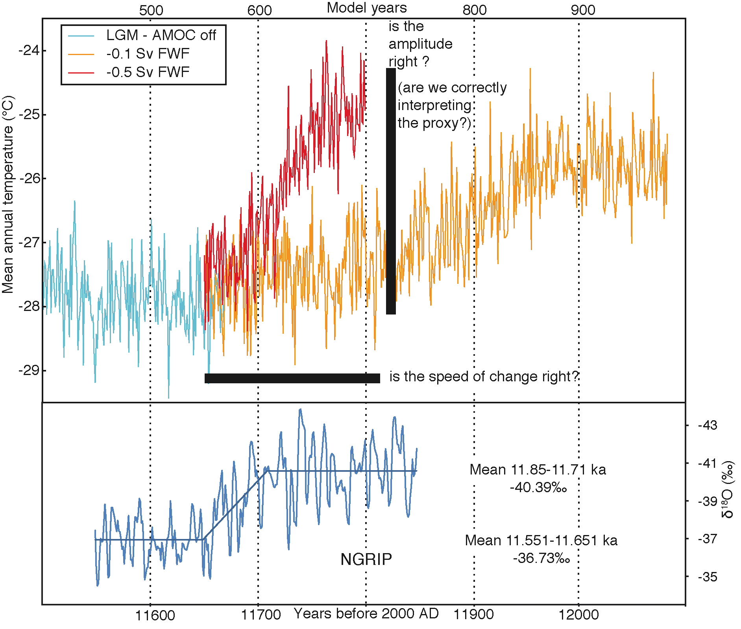
Kageyama M (2012) PAGES news 20(1): 9
Notes:
Earth System models - How well do Earth system models simulate the dynamics of global change?
Masa Kageyama
Laboratoire des Sciences du Climat et de l'Environnement, CEA Saclay, Gif-sur-Yvette, France; Masa.Kageyama@lsce.ipsl.fr
Figure 1: Qualitative comparison of modeled warming events (upper panel) with a real event as recorded in the NGRIP ice core in Greenland between 11.6 and 11.8 ka BP (lower panel; Steffensen et al. 2009). The model results are for simulations using Last Glacial Maximum forcings. (blue) reference run, Atlantic Meridional Overturning Circulation (AMOC) "turned off", (orange) with a North Atlantic fresh water forcing of -0.1 Sv and (red) of -0.5 Sv (1 Sv = 10⁶ m³ s⁻¹).

Slide 4
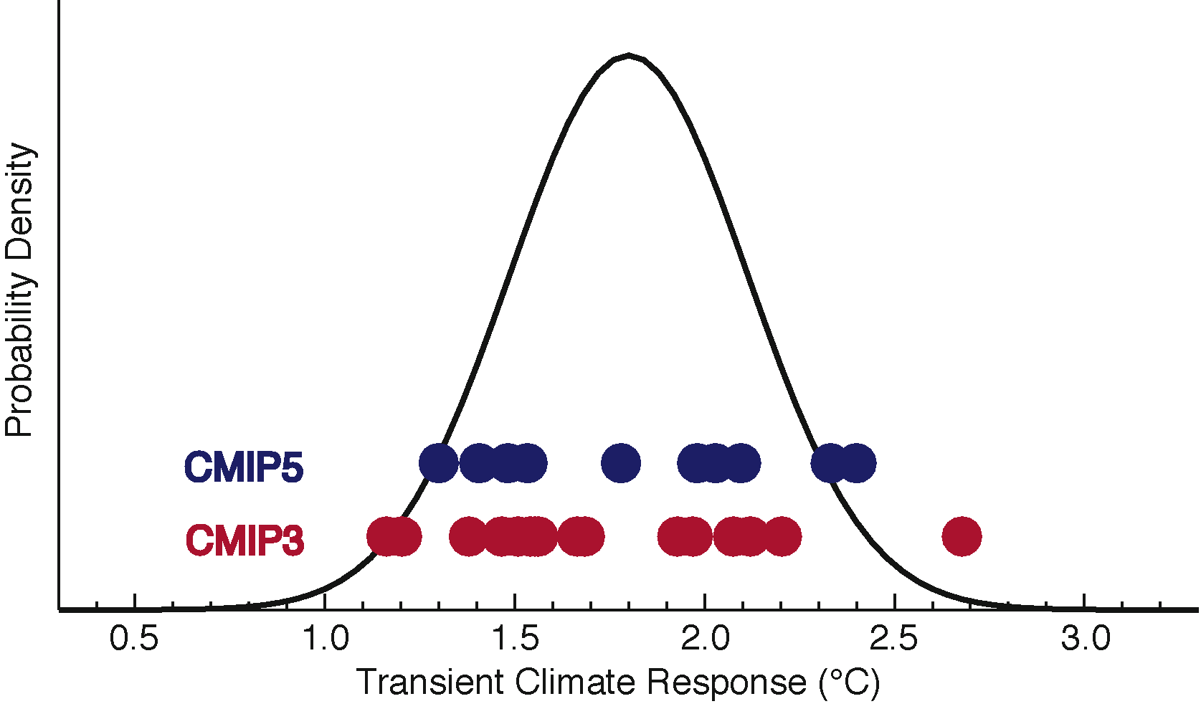
Collins M & Long D (2012) PAGES news 20(1): 10
Notes:
Climate sensitivity - How sensitive is Earth’s climate to CO₂?
Mat Collins and David Long
College of Engineering, Mathematics and Physical Sciences, Exeter University, UK; M.Collins@exeter.ac.uk
Figure 1: A comparison of estimates of the Transient Climate Response from complex models evaluated against modern observations from versions 3 and 5 of the Coupled Model Intercomparison Project (Meehl et al. 2007; Taylor et al. 2011) shown as red and blue dots respectively. A PDF of the TCR computed from a simple model with parameters constrained by observations is also shown (Gregory and Forster 2008).

Slide 5
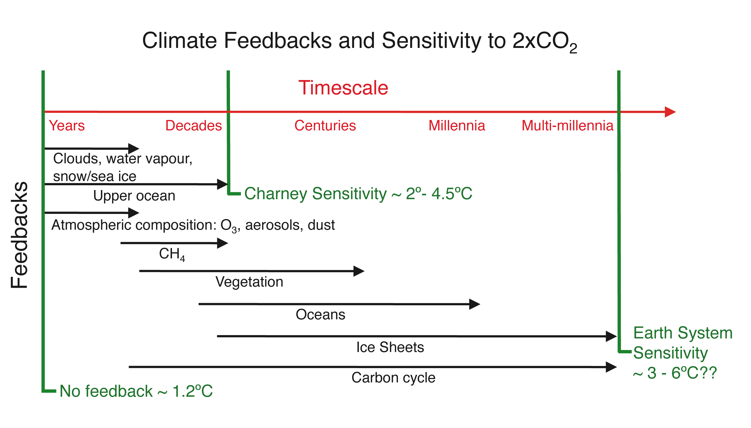
Schmidt GA (2012) PAGES news 20(1): 11
Notes:
Climate sensitivity - How sensitive is Earth’s climate to CO₂?
Gavin A. Schmidt
NASA Goddard Institute for Space Studies, New York, USA; gavin.a.schmidt@nasa.gov
Figure 1: Climate sensitivities are a function of what feedbacks are included and what timescales are being considered.

Slide 6
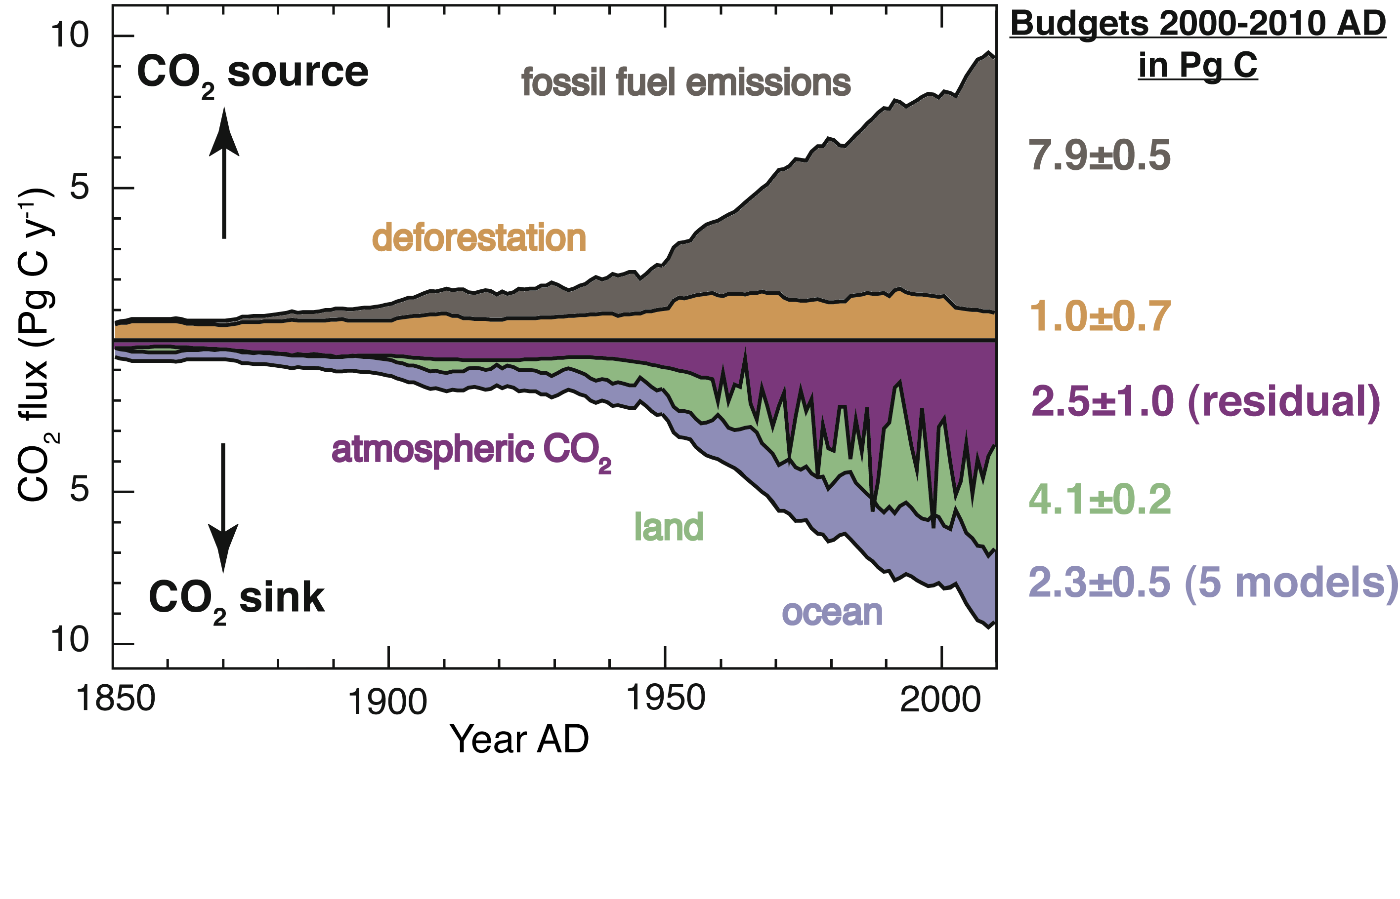
Schimel D (2012) PAGES news 20(1): 12
Notes:
Carbon cycle dynamics - How are major carbon sinks and sources varying with global change?
David Schimel
National Ecological Observatory Network, Boulder, USA; dschimel@neoninc.org
Figure 1: Human perturbation of the global carbon budget over the period 1850-2012 AD. The values on the right represent the amount of C emitted and absorbed during the last decade (2000-2010 AD). Figure modified from Global Carbon Project (2011), updated from Le Quéré et al. (2009) and Canadell et al. (2007).

Slide 7
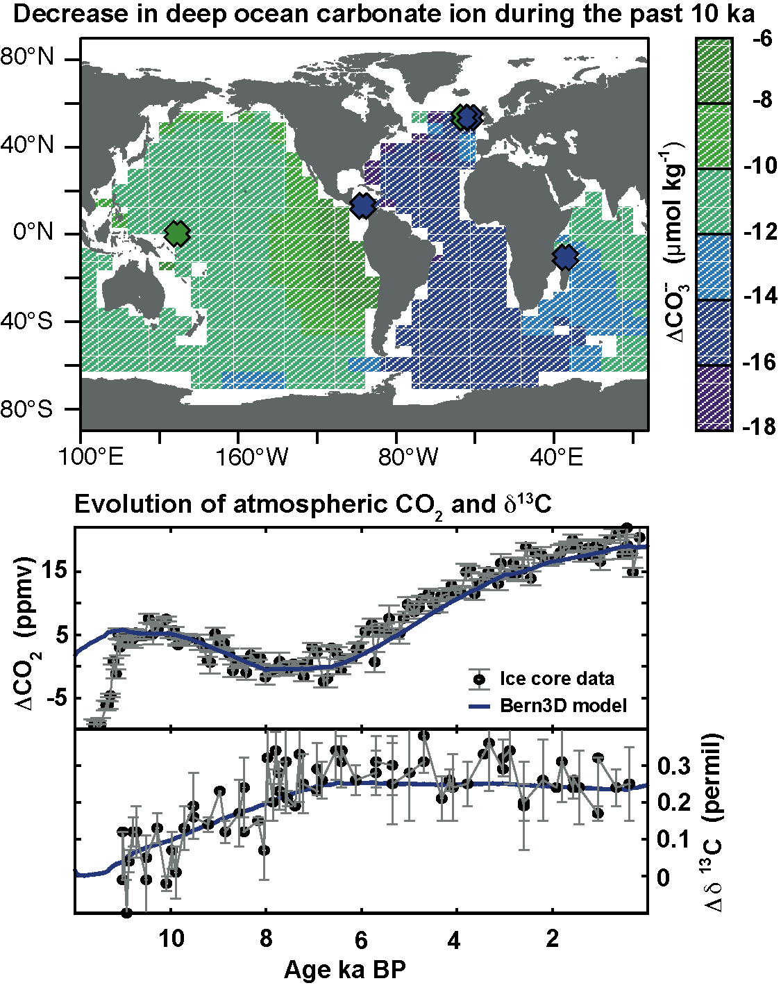
Joos F (2012) PAGES news 20(1): 13
After Menviel and Joos 2012, Paleoceanography 27(1)
Notes:
Carbon cycle dynamics - How are major carbon sinks and sources varying with global change?
Fortunat Joos
Climate and Environmental Physics and Oeschger Centre for Climate Change Research, University of Bern, Switzerland; fortunat.joos@climate.unibe.ch
Figure 1: Evolution of atmospheric CO₂ and δ¹³C of atmospheric CO₂ (lower panel) and changes in deep ocean carbonate ion concentration (μmol kg⁻¹) over the last 10 ka (upper panel). Proxy data are shown by circles and crosses, and results from the Bern3D model by blue lines and color contours (after Menviel and Joos 2012).

Slide 8
Kanzow T & Visbeck M (2012) PAGES news 20(1): 14
Notes:
Ocean circulation - Does large-scale ocean overturning circulation vary with climate change?
Torsten Kanzow and Martin Visbeck
IFM-GEOMAR, University of Kiel, Germany; tkanzow@ifm-geomar.de
Figure 1: Southward Deepwater Transport at 16°N (blue line) and Strength of Meridional Overturning at 26°N (red line) for the period 2000-2010 AD.

Slide 9
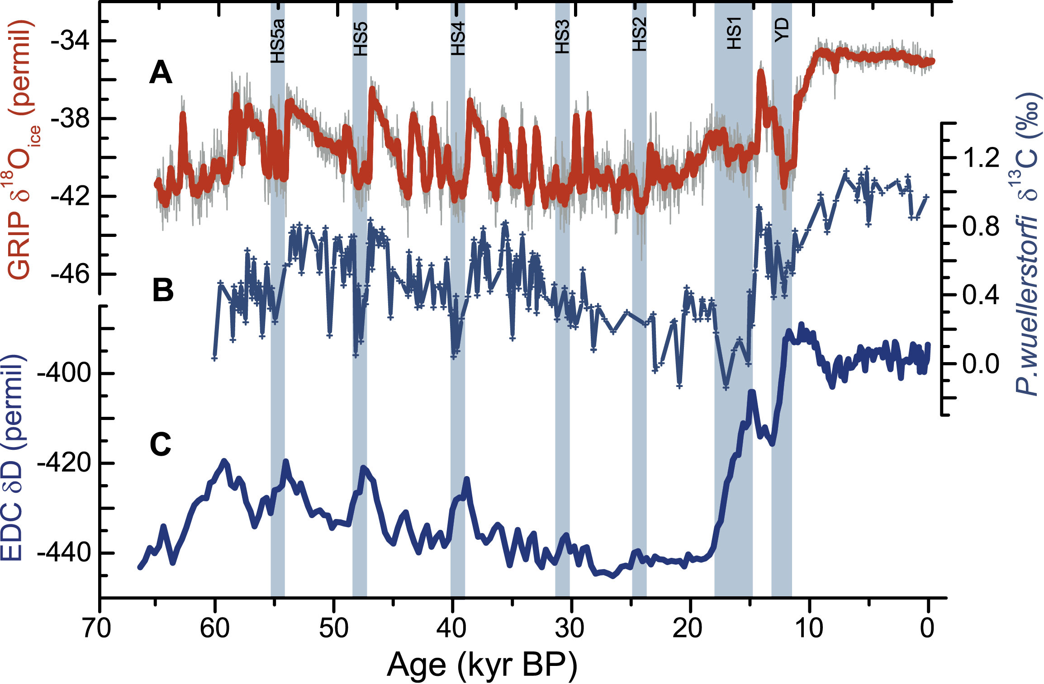
Skinner L (2012) PAGES news 20(1): 15
Notes:
Ocean circulation - Does large-scale ocean overturning circulation vary with climate change?
Luke Skinner
Department of Earth Sciences, University of Cambridge, UK; lcs32@cam.ac.uk
Figure 1: Changes in the ocean-climate system over the past 60 ka, showing climate anomalies over Greenland (A) and Antarctica (C) (Lemieux-Dudon et al. 2010) compared with evidence for ocean circulation changes from the deep Northeast Atlantic (B) (Skinner et al. 2007). The evidence for circulation changes is derived from benthic foraminiferal stable carbon isotopes, which are interpreted here to represent primarily the preformed macro-nutrient content of deep waters, and therefore the relative dominance of northern- versus southern deep-waters in the deep North Atlantic. HS: Heinrich Stadial, YD: Younger Dryas.

Slide 10
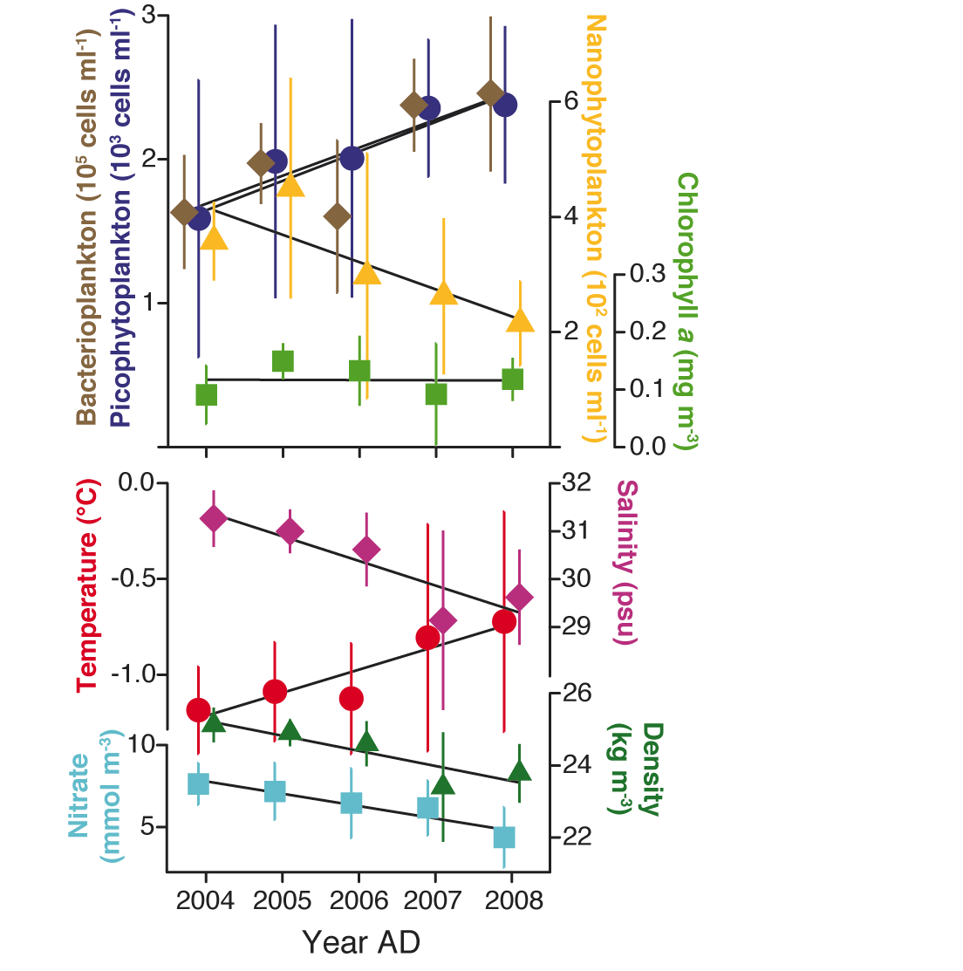
Lancelot C (2012) PAGES news 20(1): 16
Modified from Li et al. 2009, Science 326: 539
Notes:
Marine nutrient cycling - How will the ocean’s capacity of biological carbon pumping change?
Christiane Lancelot
Ecologie des Systèmes Aquatiques, Université Libre de Bruxelles, Belgium; lancelot@ulb.ac.be
Figure 1: Summer conditions in the upper water layers of the Canadian Basin. The lower panel shows the physical water properties over the period 2004-2008, the upper the response of the plankton organisms during the same period. Figure modified from Li et al. 2009.

Slide 11
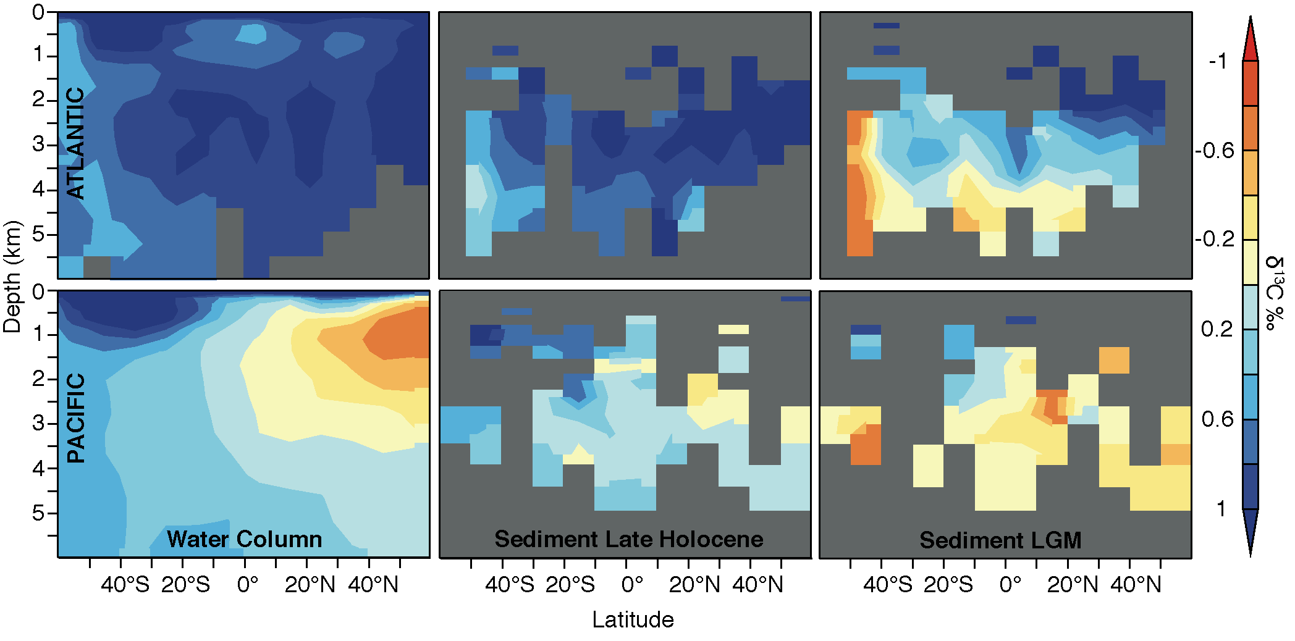
Schmittner A (2012) PAGES news 20(1): 17
Notes:
Marine nutrient cycling - How will the ocean’s capacity of biological carbon pumping change?
Andreas Schmittner
College of Oceanic and Atmospheric Sciences, Oregon State University, USA; aschmitt@coas.oregonstate.edu
Figure 1: Latitude-depth distribution of zonally averaged δ¹³C in the Atlantic (top) and Pacific (bottom). Left: modern water-column measurements from WOCE and CLIVAR cruises (Schmittner et al., unpublished data). Middle: Late Holocene sediment data. Right: LGM sediment data. Sediment data from Hesse et al. (2011) and Matsumoto et al. (2002).

Slide 12
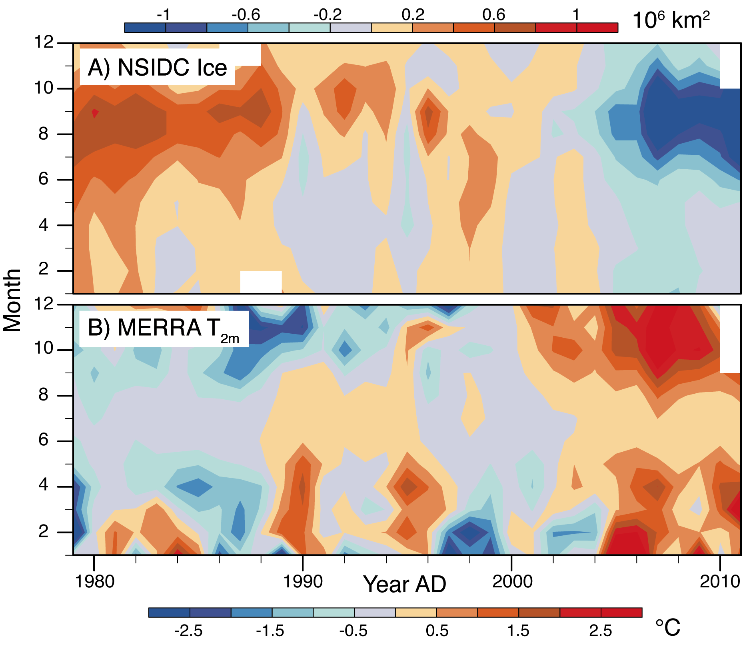
Serreze MC & Stroeve JC (2012) PAGES news 20(1): 18
Notes:
Arctic sea ice - When will the Arctic Ocean become ice-free and what will be the effects?
Mark C. Serreze and Julienne C. Stroeve
Cooperative Institute for Research in Environmental Science and Department of Geography, University of Colorado, Boulder, USA; serreze@nsidc.org
Figure 1: Time series by month (y-axis) and year (x-axis) of (top) anomalies in Arctic sea ice extent based on the satellite passive microwave record and (bottom) corresponding anomalies in 2-meter air temperate for the Arctic Ocean based on the NASA Modern Era Retrospective-Analysis for Research and Applications (MERRA). Anomalies are calculated with respect to the period 1979-2010.

Slide 13
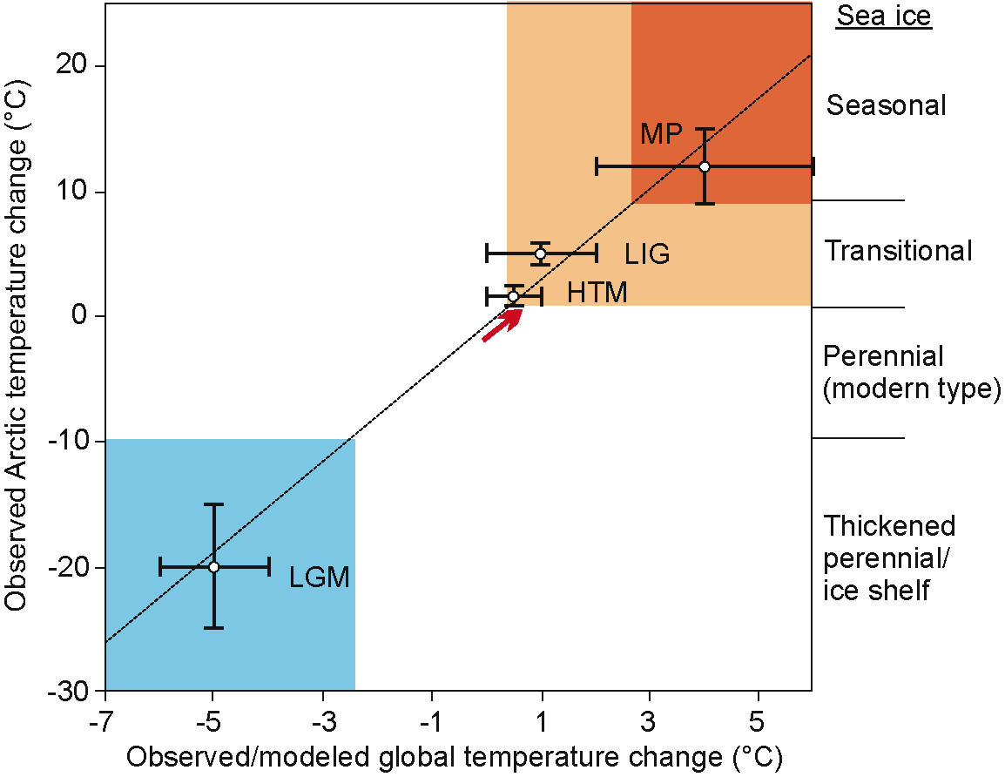
Polyak L (2012) PAGES news 20(1): 19
Modified from Miller et al. 2010, Quaternary Science
Reviews 29: 1779-1790
Notes:
Arctic sea ice - When will the Arctic Ocean become ice-free and what will be the effects?
Leonid Polyak
Byrd Polar Research Center, Ohio State University, Columbus, USA; polyak.1@osu.edu
Figure 1: Schematic representation of Arctic sea-ice conditions inferred from paleoclimatic data (e.g. Polyak et al. 2010; Funder et al. 2011; Polyak and Jakobsson 2011). Paleo-temperature anomalies are shown for Last Glacial Maximum (LGM; ~20 ka), Holocene Thermal Maximum (HTM; ~8 ka), Last Interglaciation (LIG; ~130 ka), and middle Pliocene (MP; ~3.5 Ma) (from Miller et al. 2010). Punctured trend line represents the Arctic Amplification. Red arrow shows instrumentally observed temperature change, consistent with observed loss of sea ice approaching the “transitional” state with increasingly large seasonally ice-free areas (see accompanying paper by Serreze and Stroeve).

Slide 14
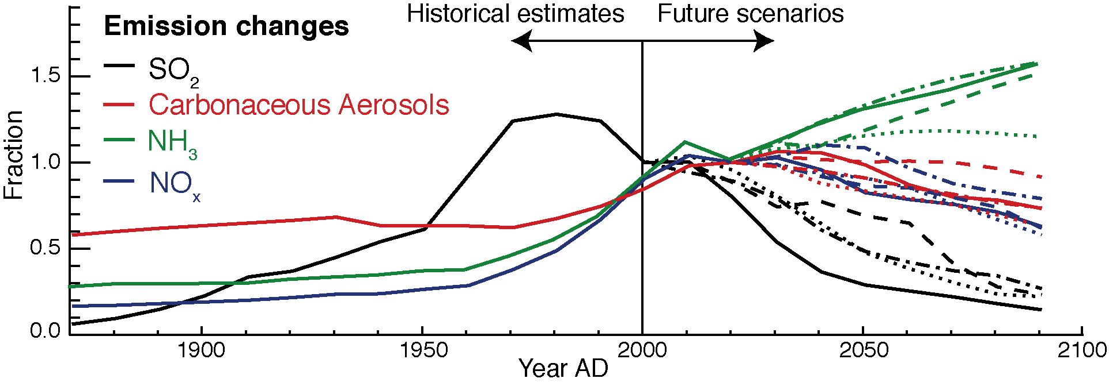
Albani S & Mahowald N (2012) PAGES news 20(1): 20
Calculation based on Mahowald (in press), Atmospheric Biogeochemistry,
Encyclopedia of Sustainable Science and Technology, Springer
Notes:
Aerosols and climate – How sensitive is earth’s climate to atmospheric aerosols?
Samuel Albani¹ and Natalie Mahowald²
¹Department of Environmental Sciences, University of Milano-Bicocca, Milano, Italy; samuel.albani@unimib.it
²Department of Earth and Atmospheric Sciences, Cornell University, Ithaca, USA
Figure 1: Historical and projected aerosol emissions relative to 2000 AD emissions. Sulfur dioxide forms sulfate aerosols, while about half the ammonia and nitrogen oxides form nitrogen-based aerosols in the atmosphere. Carbonaceous aerosols include both black and organic carbon and the estimated emissions here do not include secondary aerosol formation in the atmosphere. Calculations based on Mahowald (in press).

Slide 15
Ganopolski (2012) PAGES news 20(1): 21
Based on Mahowald et al. 2006, Journal of Geophysical Research 111
Notes:
Aerosols and climate – How sensitive is earth’s climate to atmospheric aerosols?
Andrey Ganopolski
Potsdam Institute for Climate Impact Research, Potsdam, Germany; andrey@pik-potsdam.de
Figure 1: Modeled dust deposition under preindustrial climate conditions (left) and Last Glacial Maximum (right) based on Mahowald et al. (2006).

Slide 16
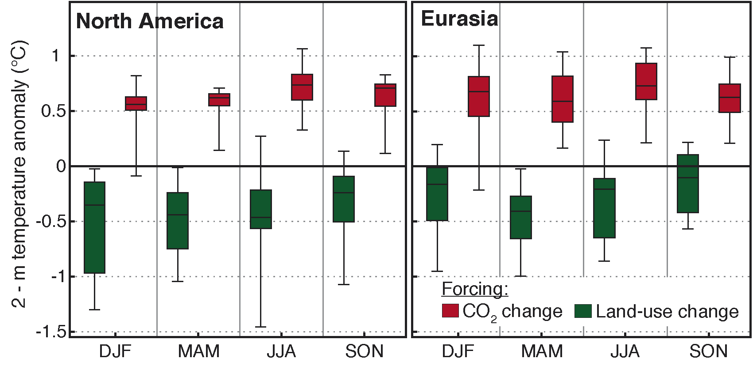
van den Hurk et al. (2012) PAGES news 20(1): 22
Modified from de Noblet-Ducoudré et al. (in press),
Journal of Climate, doi: 10.1175/JCLI-D-11-00338.1
Notes:
Land cover change - To what degree do human land cover dynamics affect climate change?
Bart van den Hurk¹, S.I. Seneviratne² and L. Batlle-Bayer³
¹Royal Netherlands Meteorological Institute, De Bilt, Netherlands; bart.van.den.hurk@knmi.nl
²Department of Environmental Systems Science, Swiss Federal Institute of Technology Zürich, Switzerland; ³Institute for Marine and Atmospheric research, University of Utrecht, Netherlands
Figure 1: Effects of land use and CO₂ forcings on temperature change from pre-industrial to present-day in two heavily deforested areas (central North America and central Eurasia) as simulated with seven atmosphere-land models (de Noblet-Ducoudré et al., in press). Most simulations suggest that the propagating land use resulted in significant regional cooling, which approximately counteracted the concurrent CO₂-related warming in these regions.

Slide 17
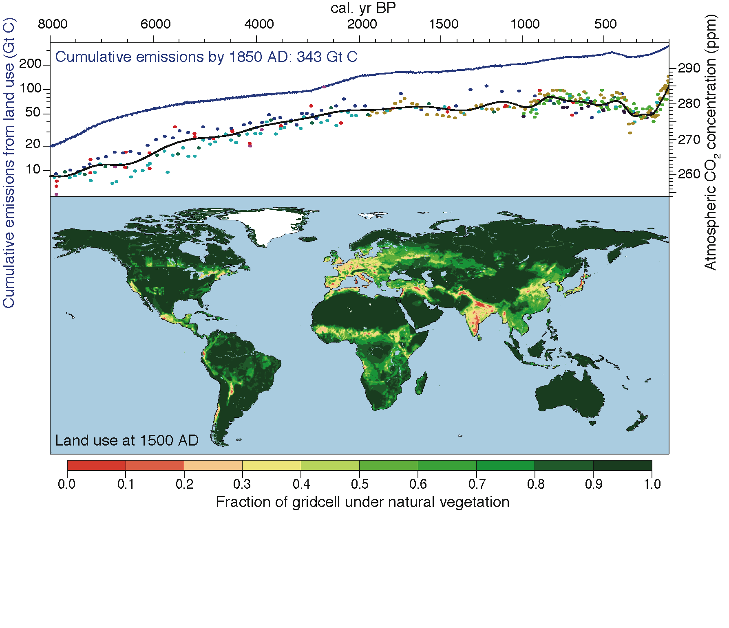
Kaplan JO (2012) PAGES news 20(1): 23
Based on Kaplan et al. (2010) The Holocene 21: 775-791
Notes:
Land cover change - To what degree do human land cover dynamics affect climate change?
Jed O. Kaplan
ARVE Group, Swiss Federal Institute of Technology Lausanne, Switzerland; jed.kaplan@epfl.ch
Figure 1: Top: Preindustrial Holocene atmospheric CO₂ concentrations measured in Antarctic ice cores (dots, black line), and carbon emissions as a result of anthropogenic land cover change (blue line). Bottom: Global land use at 1500 AD, before the collapse of the indigenous populations of the Americas following European contact. For details and data sources, see Kaplan et al. 2011.

Slide 18
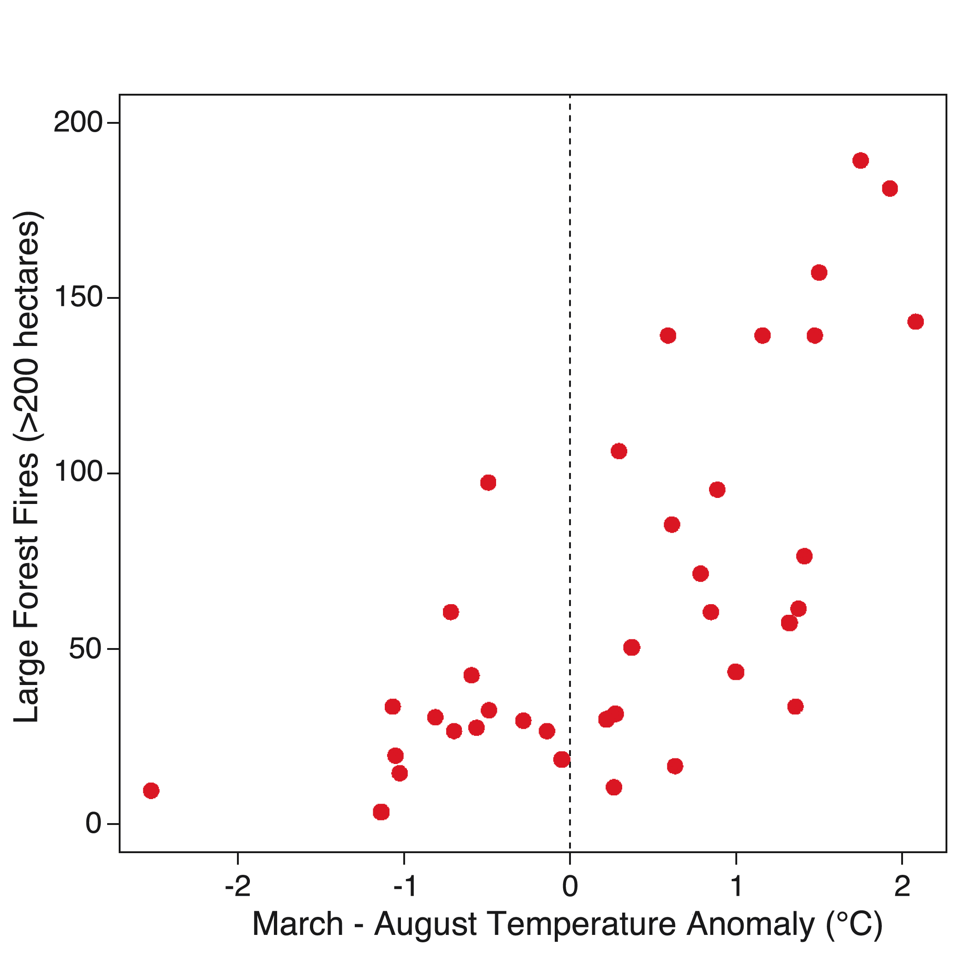
Westerling AL (2012) PAGES news 20(1): 24
Notes:
Fire - Are we facing an increase in wildfires?
Anthony L. Westerling
Sierra Nevada Research Institute, University of California, Merced, USA; awesterling@ucmerced.edu
Figure 1: The number of large forest wildfires (vertical axis) versus average March through August temperature anomalies (horizontal axis) for 1972-2008 in Western US forests. Anomalies were constructed subtracting the long-term mean for 1972-1990. Fires are all large (> 200 ha) fires reported by the United States’ Bureau of Indian Affairs, National Park Service, and Forest Service as burning in forests. All fires were classified as “action” fires on which suppression was attempted (fires used to manage vegetation were excluded). See Westerling et al. 2006 and Westerling et al 2011 for data and methodology.

Slide 19
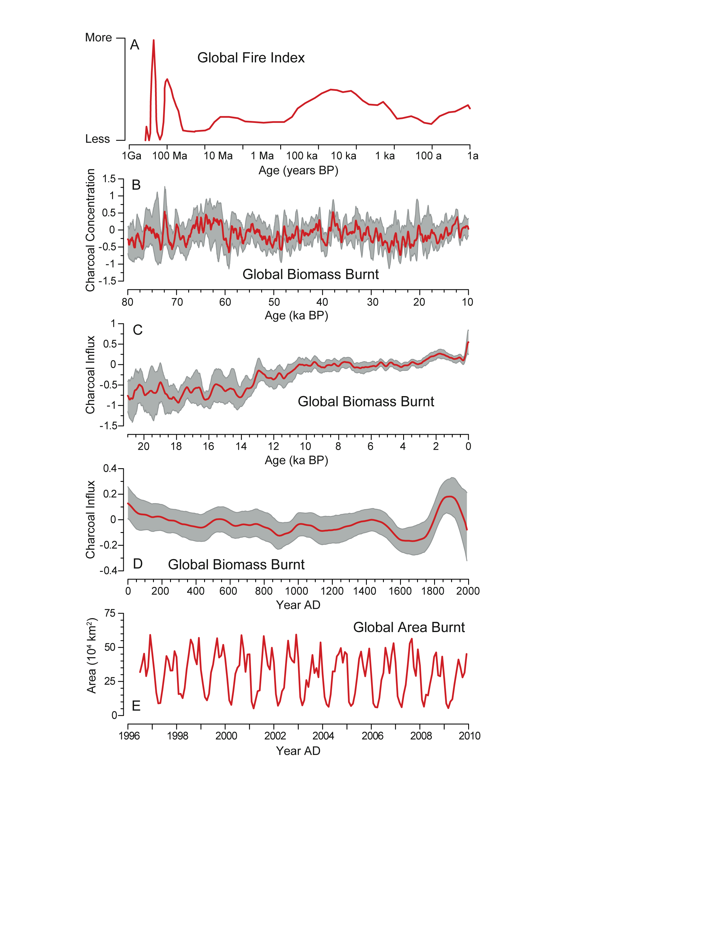
Harrison SP & Bartlein PJ (2012) PAGES news 20(1): 25
Notes:
Fire - Are we facing an increase in wildfires?
Sandy P. Harrison¹ and Patrick J. Bartlein²
¹School of Biological Sciences, Macquarie University, North Ryde, Australia; sandy.harrison@mq.edu.au
²Department of Geography, University of Oregon, Eugene, USA
Figure 1: The incidence of wildfire varies on multiple timescales. The record for the past billion years (1 Ga) (A) is a qualitative index of global fire based on discontinuous sedimentary charcoal records (Bowman et al. 2009). The record for the past 80 ka (B) is a global composite of 30 sedimentary charcoal records (Daniau et al. 2010a), that for the past 21 ka (C) is a global composite of ca. 700 sedimentary charcoal records (Daniau et al., unpublished data) and that for the past 2 ka is a global composite of ca. 400 sedimentary charcoal records (D; Marlon et al. 2008). The biomass burnt record in B, C and D is expressed as z-score anomalies from a long-term mean. Global area burnt from 1997 to 2009 (E) is derived from satellite-based remote sensing (GFED v3.1; Giglio et al. 2010).

Slide 20
Wang B (2012) PAGES news 20(1): 26
Notes:
Monsoon climate – Will summer rain increase or decrease in monsoon regions?
Bin Wang
Department of Meteorology and International Pacific Research Center, University of Hawaii, Honolulu, USA; wangbin@hawaii.edu
Figure 1: Multi-model mean changes in precipitation for boreal winter (DJF) and summer (JJA). Changes are given for the SRES A1B scenario, for the period 2080 to 2099 relative to 1980 to 1999. Stippling denotes areas where the magnitude of the multi-model ensemble mean exceeds the inter-model standard deviation. In the global monsoon domain (red contours) the summer-minus-winter precipitation exceeds 2.5 mm/day and the summer precipitation exceeds 55% of the annual total (Wang and Ding 2008). The dry regions with summer precipitation <1 mm/day are outlined in gray. The merged Global Precipitation Climatology Project/Climate Prediction Center Merged Analysis of Precipitation data were used to determine the monsoon and arid regions.

Slide 21
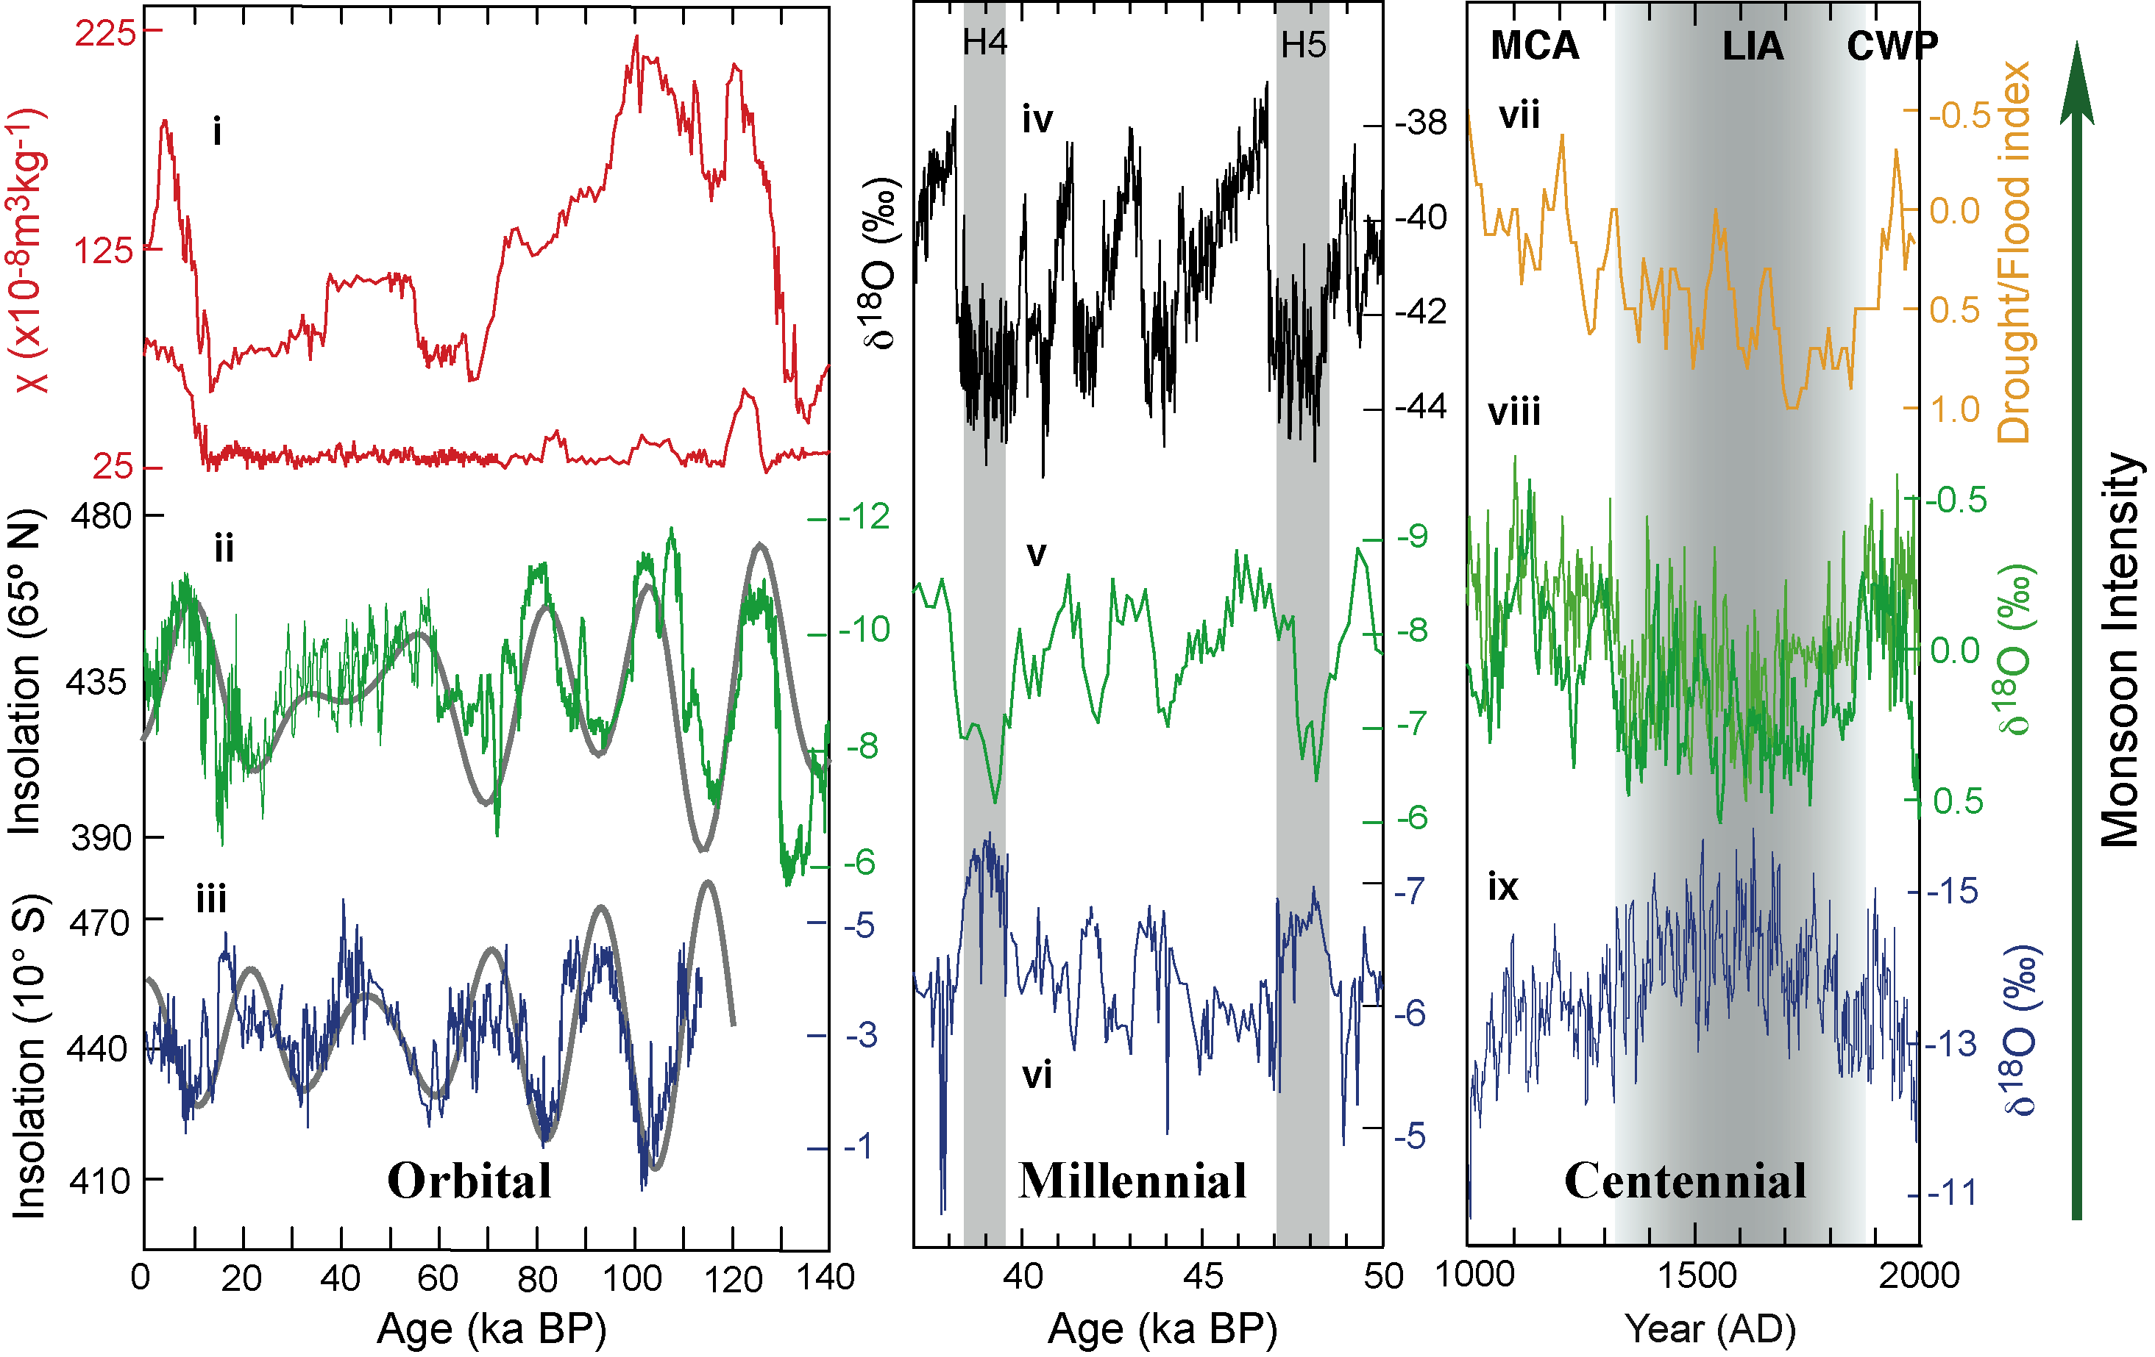
Cheng H et al. (2012) PAGES news 20(1): 27
Notes:
Monsoon climate – Will summer rain increase or decrease in monsoon regions?
Hai Cheng^{1,2}, Ashish Sinha³ and Steven M. Colman⁴
¹Institute of Global Environmental Change, Xi’an Jiaotong University, Xi’an, China; cheng021@umn.edu
²Department of Earth Sciences, University of Minnesota, Minneapolis, USA; ³Department of Earth Science, California State University,
Carson, USA; ⁴Large Lakes Observatory, University of Minnesota, Duluth, USA
Figure 1: Paleo-monsoon variability on orbital (left), millennial (middle) and centennial (right) time scales. (i) Chinese loess magnetic susceptibility (Sun et al. 2006) reflects AM glacial-interglacial variablility. (ii) Speleothem oxygen isotope (δ¹⁸O) records from China (Wang et al. 2008) and (iii) SE Brazil (Cruz et al. 2005) illustrate precessional cyclicity that follows summer insolation in their respective hemispheres (gray curves; Berger 1978) and anti-phasing between the AM and the SAM. (iv) Greenland ice core δ¹⁸O as a temperature approximation (Svensson et al. 2008). (v) Speleothem δ¹⁸O for AM (Wang et al. 2008) and (vi) SAM from northern Peru (Cheng et al., unpublished). Periods of Greenland warmth correspond with intense AM but are anti-phased with SAM intensity. (vii, viii) AM records from the summer monsoon fringes in China. (vii) Longxi Drought/Flood index based on historical literatures (Tan et al. 2011). (viii) Wangxiang (Zhang et al. 2008) and Huangye (Tan et al. 2011) speleothem records. (ix) Pumacocha lake record from Peru (Bird et al. 2011). MCA=Medieval Climate Anomaly; LIA=the Little Ice Age; CWP=Current Warm Period; H4 and H5 = Heinrich stadials.

Slide 22
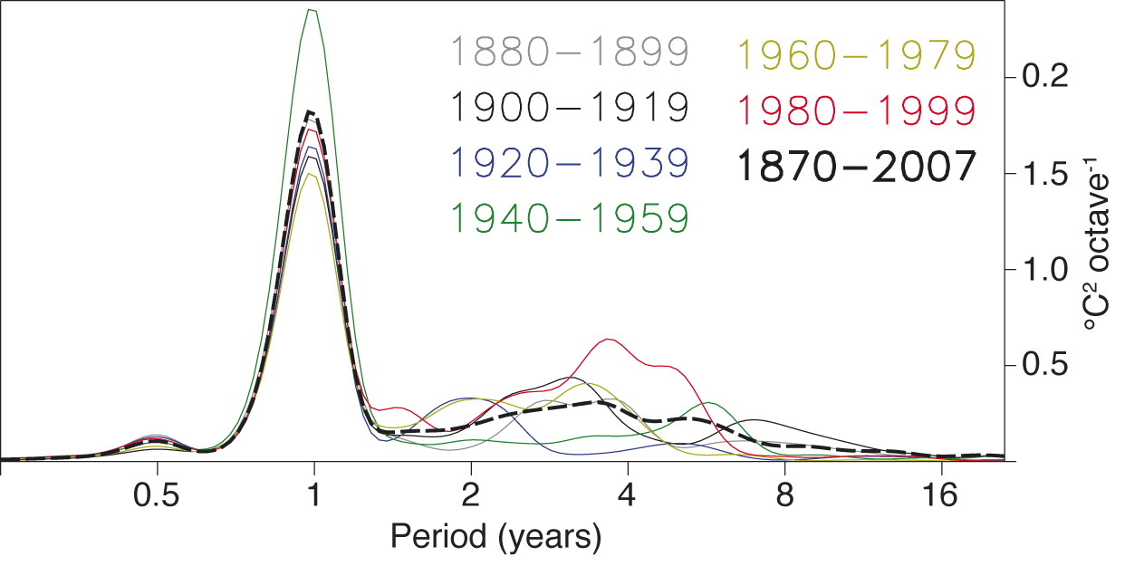
Clement A (2012) PAGES news 20(1): 28
Figure after Wittenberg (2009) Geophysical Research Letters 36
Notes:
El Nino-Southern Oscillation - What is the outlook for ENSO?
Amy Clement
Rosenstiel School of Marine and Atmospheric Science, University of Miami, USA; aclement@rsmas.miami.edu
Figure 1: Power spectra of NINO3 SSTs from the ERSST.v3 historical reconstruction (Smith et al. 2008), as a function of the period in octaves of the annual cycle. The area to the left of each curve represents the spectral power within a frequency band. Figure after Wittenberg (2009).

Slide 23
Emile-Geay (2012) PAGES news 20(1): 29
Notes:
El Nino-Southern Oscillation - What is the outlook for ENSO?
Julien Emile-Geay
Department of Earth Sciences & Center for Applied Mathematical Sciences, University of Southern California, Los Angeles, USA; julieneg@usc.edu
Figure 1: Comparison of recent ENSO reconstructions. (left axis) NINO3.4 from, W10 and EG12, NINO3 from M09, Proxy ENSO index from B09 (inverted scale), (right axis) 21-year running ENSO variance from L11 All series have been 30-year lowpass-filtered. See text for details.

Slide 24
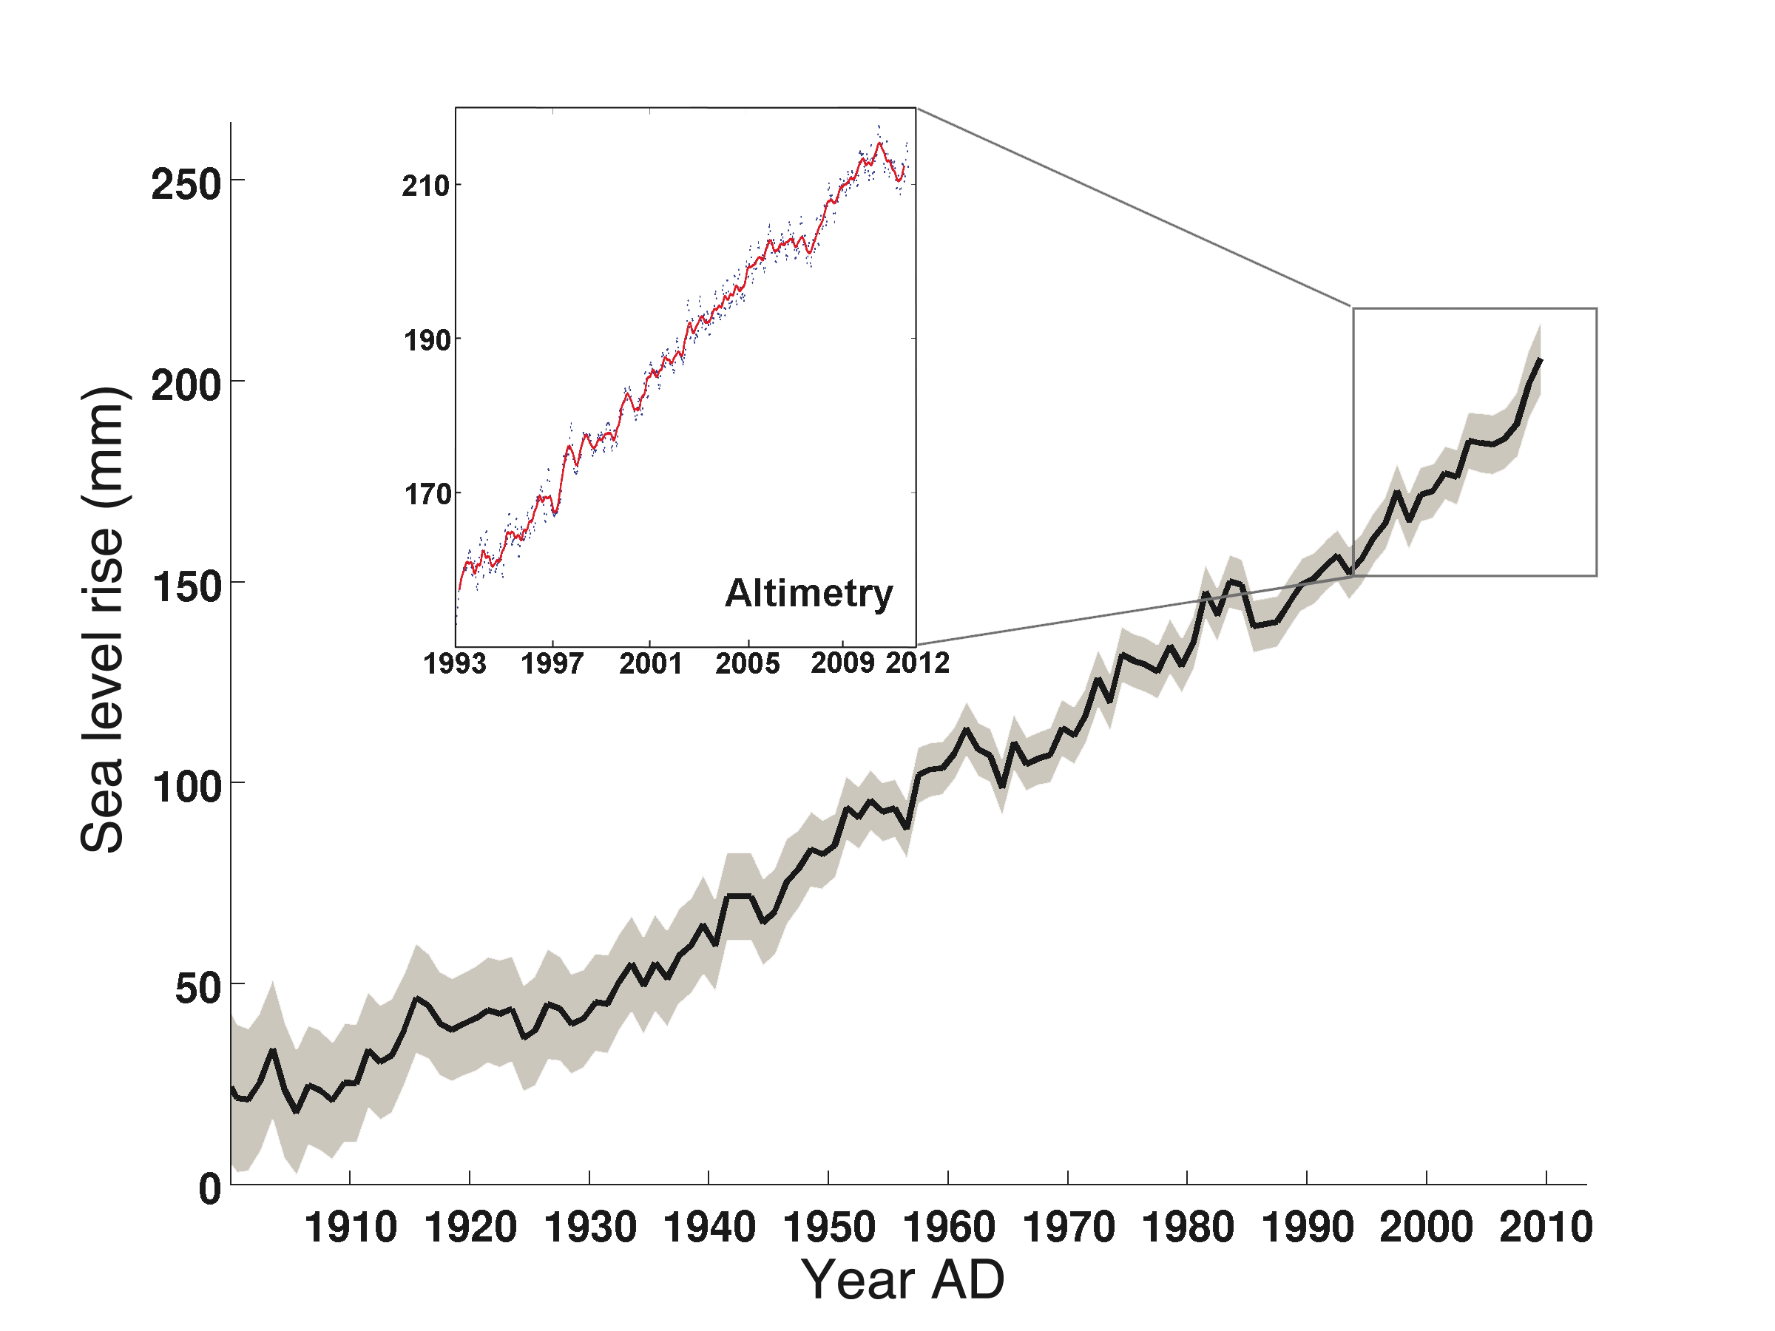
Cazenave A (2012) PAGES news 20(1): 30
Notes:
Sea level rise - How much and how fast will sea level rise over the coming centuries?
Anny Cazenave
Laboratoire d’Etudes en Géophysique et Océanographie Spatiale, Centre National d'Etudes Spatiales, Toulouse, France; anny.cazenave@legos.obs-mip.fr
Figure 1: Twentieth century sea level curve (in black and associated uncertainty in light gray) based on tide gauge data and additional information (data from Church and White 2011). Box: altimetry-based sea level curve between 1993 and 2011 (data from AVISO; www.aviso.oceanobs.com/en/data/products/sea-surface-height-products/global/msla/index.html). Blue points represent data at 10-day intervals, the red curve their 4-month smoothing (from Meyssignac and Cazenave, unpublished data).

Slide 25
Siddall M & Pollard D (2012) PAGES news 20(1): 31
Notes:
Sea level rise - How much and how fast will sea level rise over the coming centuries?
Mark Siddall¹ and David Pollard²
¹Department of Earth Sciences, University of Bristol, UK; mark.siddall@bristol.ac.uk
²Earth and Environmental Systems Institute, Pennsylvania State University, University Park, USA
Figure 1: Snapshots of modeled ice distribution, essentially as in Pollard and DeConto 2009, showing collapse of WAIS marine ice leading into Marine Isotope Stage 31, a major interglacial event ca. 1.08 to 1.06 Ma (Scherer et al. 2008; DeConto et al., unpublished data). Grounded ice elevations (m) are shown by the rainbow scale, and floating ice thicknesses (m) by the pink scale. The approximate location of Cape Roberts and ANDRILL sediment cores (Scherer et al. 2008; Naish et al. 2009) is shown by a black dot.

Slide 26
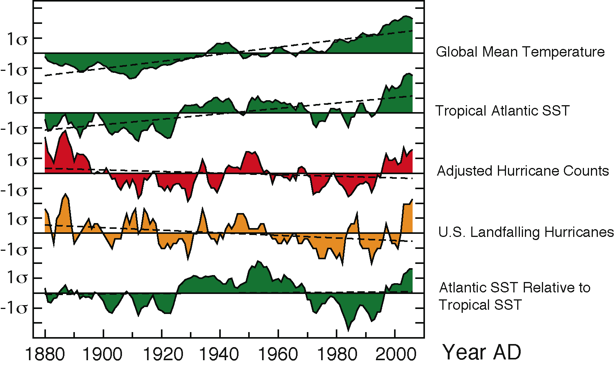
Knutson TR et al. (2012) PAGES news 20(1): 32
Adapted from Vecchi & Knutson (2011)
Journal of Climate 24: 1736-1746
Notes:
Hurricanes and Typhoons – Will tropical cyclones become stronger and more frequent?
Thomas R. Knutson, I.M. Held and G.A. Vecchi
Geophysical Fluid Dynamics Laboratory/NOAA, Princeton, USA; Tom.Knutson@noaa.gov
Figure 1: Normalized anomalies relevant to Atlantic tropical cyclone activity changes: Global mean temperature (green, top); August-October sea surface temperature (SST) in the tropical Atlantic main development region (MDR; 10-20°N, 80-20°W; green, second from top); hurricane counts adjusted for missing hurricanes based on ship-track density (red); US landfalling hurricanes (no adjustments; orange), and MDR SST minus tropical mean SST (green, bottom). Vertical axis tick marks denote one standard deviation intervals. Curves are five-year running means; dashed lines are linear trends. Only the top three series have significant linear trends (p<0.05). Source: Vecchi and Knutson (2011).

Slide 27
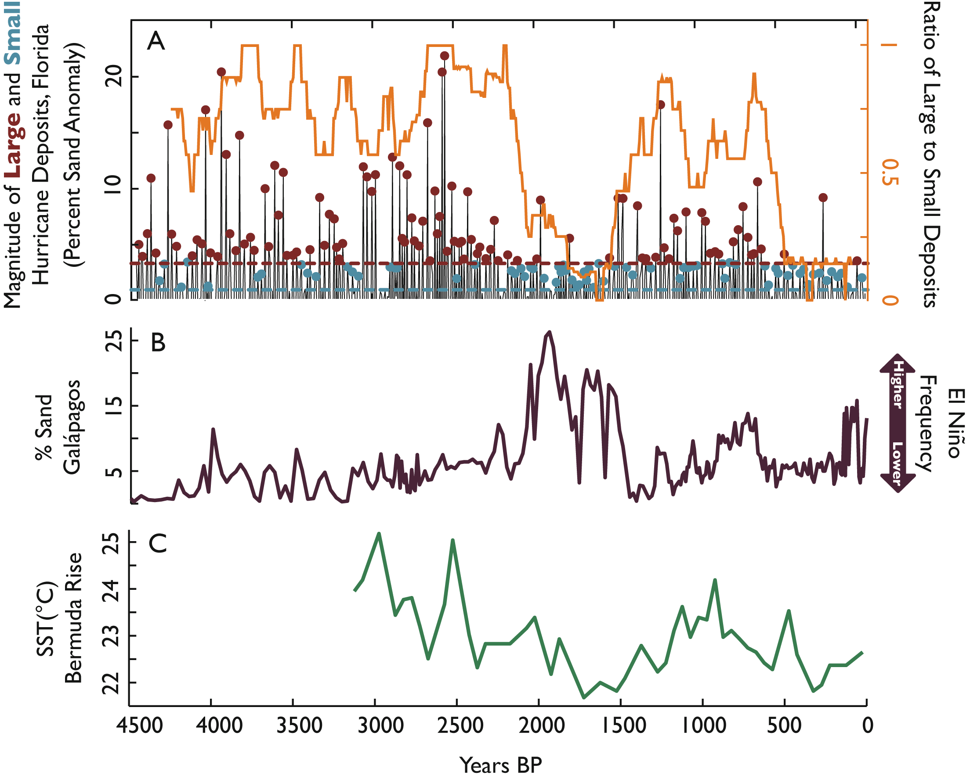
Lane P & Donnelly JP (2012) PAGES news 20(1): 33
Notes:
Hurricanes and Typhoons – Will tropical cyclones become stronger and more frequent?
Philip Lane and Jeffrey P. Donnelly
Woods Hole Oceanographic Institution, Woods Hole, USA; jdonnelly@whoi.edu
Figure 1: A) shows a 4500-year record of hurricane storm surges at Mullet Pond, Florida. Blue and red dots represent chronologies of small and large storm deposits as defined by the dashed blue and red threshold lines, respectively. The orange curve is the ratio of intense to total activity found by applying a 157-year sliding window to the chronologies of discrete events. B) shows a proxy record of El Nino frequency based on lake level inferred from sand content in the crater lake El Junco in the Galapagos (Conroy et al. 2008). C) shows a time series of foraminiferal δ¹⁸O (sea surface density) from the Bermuda Rise, inferred SST is shown on the y-axis, though a portion (estimated to be about one third) of the variability in δ¹⁸O is thought to be related to changes in salinity also (Keigwin 1996).

Slide 28
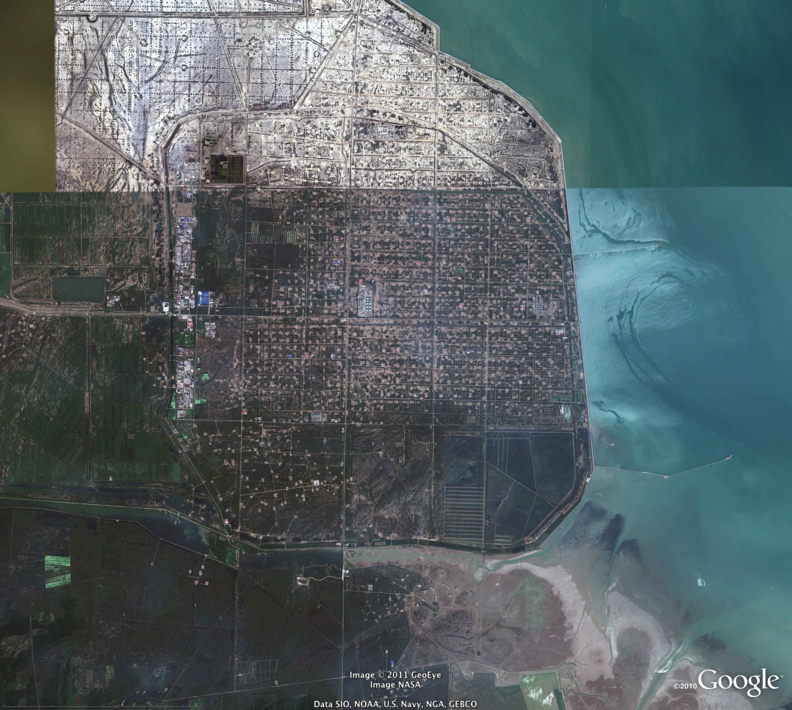
Syvitski J (2012) PAGES news 20(1): 34
Image from Google Earth Pro
Notes:
Vulnerability of coastlines - How do environmental changes affect coastlines and river deltas?
James Syvitski
INSTAAR, University of Colorado, Boulder, USA; James.Syvitski@Colorado.edu
Figure 1: GEO-EYE satellite image of the Yellow River (Huanghe) delta. Each year 33.6 Mt of crude oil are extracted from the delta. The Gudong Seawall, built 1985-1988 to protect the oil fields from inundation, is 10 m thick at its top and 38 m at its bottom. The oilrigs are laid out on a grid pattern. The field is presently below sea level by 1 to 2 m, protected from the sea by the Seawall. Image from Google Earth Pro; pixel resolution is ~1 m.

Slide 29
Leorri E & Mallinson D (2012) PAGES news 20(1): 35
Modified from Grand Pre C et al. (2011)
Quaternary Research 76: 319-334
Notes:
Vulnerability of coastlines - How do environmental changes affect coastlines and river deltas?
Eduardo Leorri and David Mallinson
Department of Geological Sciences, East Carolina University, Greenville, USA; leorrie@ecu.edu
Figure 1: A) Map of the Pamlico estuarine system in North Carolina showing the location of the main active inlets. B) Paleoenvironmental reconstruction of the southern Pamlico Sound region ca. 850 AD (modified from Grand Pre et al. 2011). Barrier island destruction along the southern Outer Banks resulted in a shallow, submarine sand shoal and localized deeper tidal channels over which normal marine waters were advected. The Cape Hatteras region exhibited several inlets with large flood-tide deltas.

Slide 30
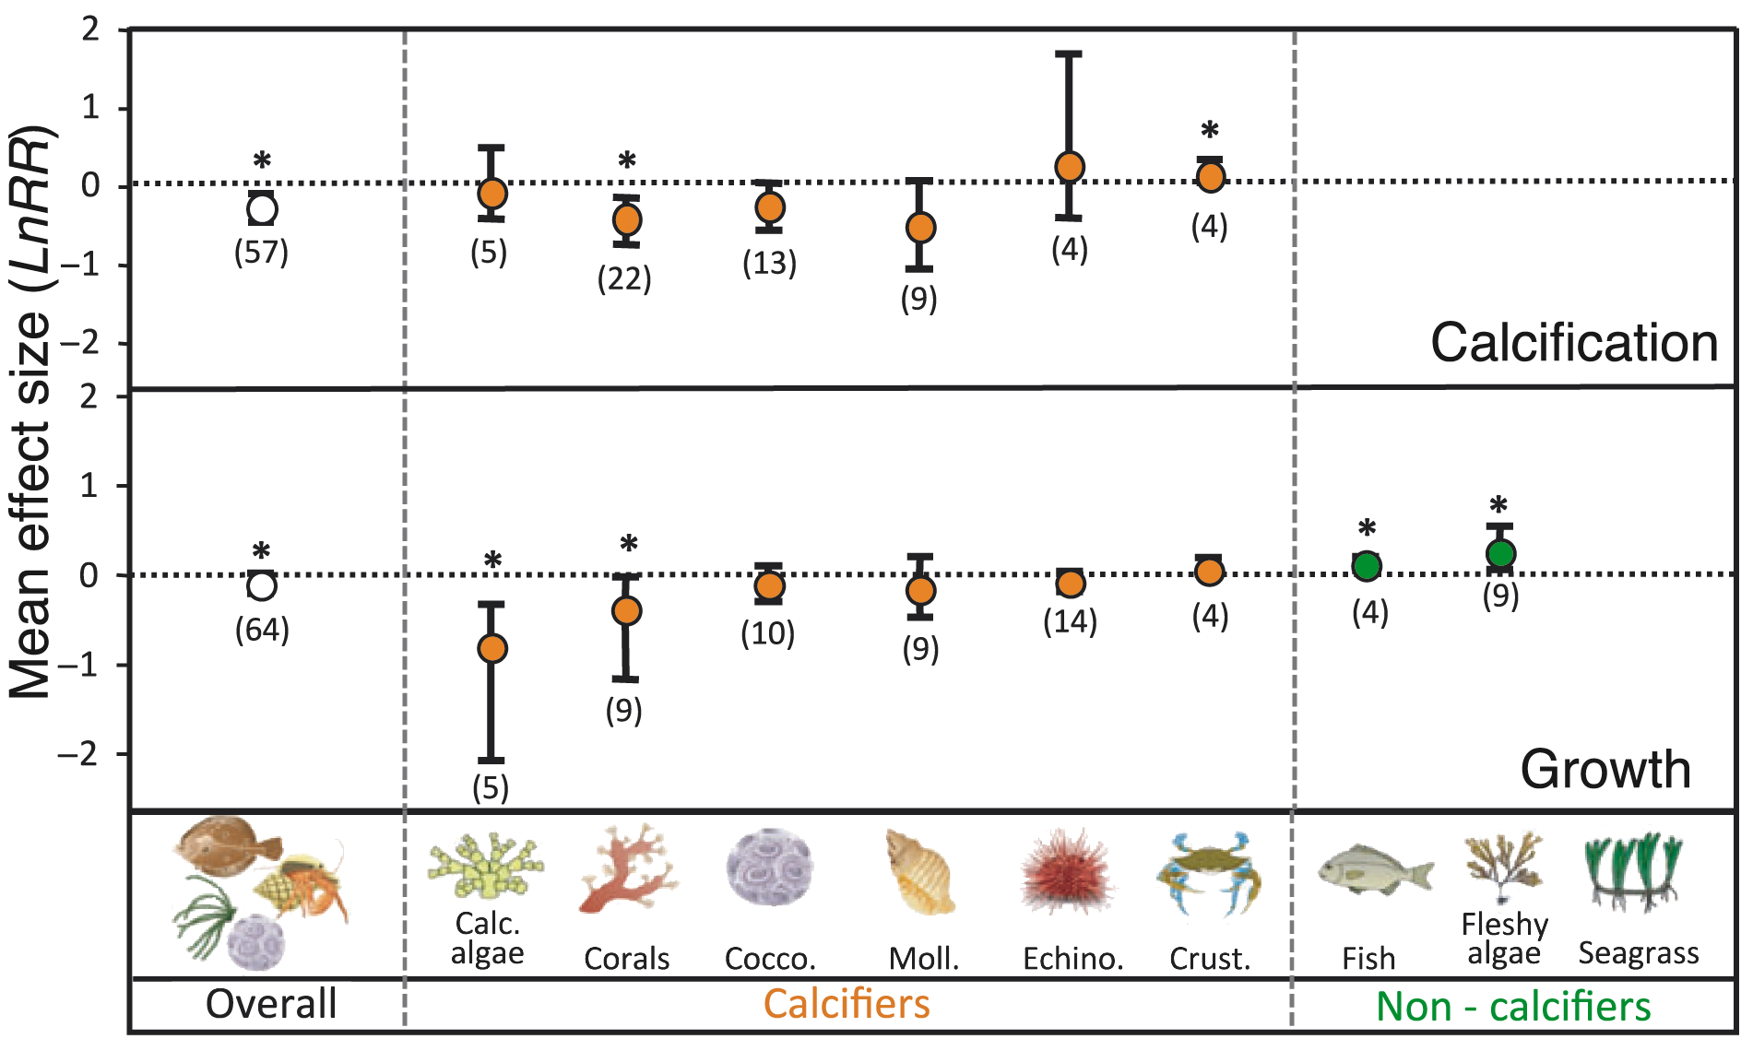
Gattuso JP (2012) PAGES news 20(1): 36
Adapted from Kroeker et al. (2010) Ecology Letters 13: 1419-1434
Notes:
Ocean Acidification – How will ongoing ocean acidification affect marine life?
Jean-Pierre Gattuso
CNRS and Université Pierre et Marie Curie, Villefranche-sur-Mer, France; gattuso@obs-vlfr.fr
Figure 1: Effects of ocean acidification on marine organisms. Mean effect size and 95% bias-corrected bootstrapped confidence interval are shown. The number of experiments used to calculate mean effect sizes are shown in parentheses. Asterisks (*) mark significant mean effect sizes (95% confidence interval does not overlap zero). Figure adapted from Kroeker et al. (2010).

Slide 31
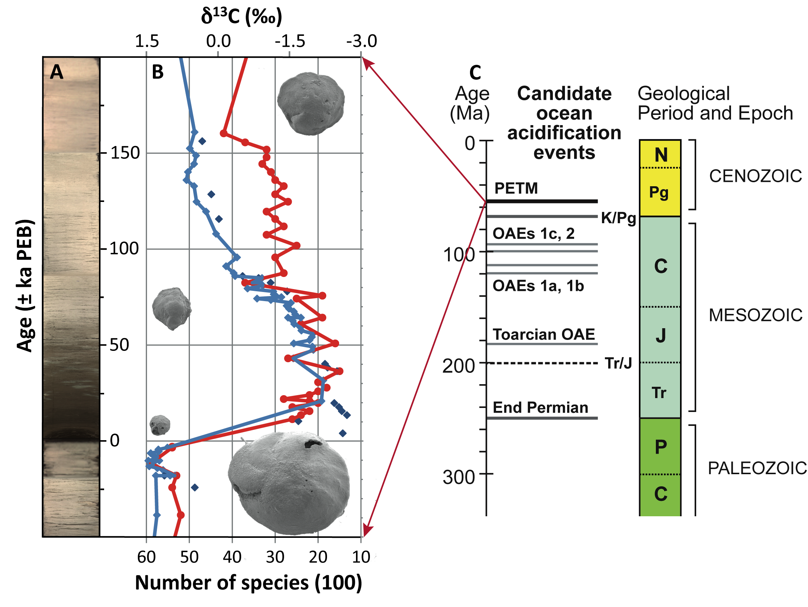
Thomas E (2012) PAGES news 20(1): 37
Notes:
Ocean Acidification – How will ongoing ocean acidification affect marine life?
Ellen Thomas^{1,2}
¹Department of Geology and Geophysics, Yale University, New Haven, USA; ellen.thomas@yale.edu
²Department of Earth & Environmental Sciences, Wesleyan University, Middletown, USA
Figure 1: The Paleocene-Eocene Thermal Maximum at Walvis Ridge in the southeastern Atlantic Ocean, off Namibia. Paleo-water depth ~1500 m. A) Core image shows carbonate ooze (light colors) and clay (dark colors), where carbonate has been dissolved during ocean acidification (Zachos et al. 2005). Sediment is plotted on an age scale in ka relative to the Paleocene-Eocene Boundary (PEB) (Hönisch et al., in press). B) Blue curve and blue dots show carbon isotope excursion (CIE) in shells of deep-sea benthic foraminifera (McCarren et al. 2008). Red curve shows decrease in number of species of deep-sea benthic foraminifera during extinction coeval with CIE (Thomas, unpublished data). Pictures show specimens of the benthic foraminifer Nuttallides truempyi, used for isotope analysis, survivor of the extinction. All at the same magnification, showing severe decrease in size during ocean acidification, placed at the location where they occurred in the sediment. C) Climate-carbon cycle disturbance in the oceans during the last 300 Ma of Earth history (modified after Kump et al. 2009).

Slide 32
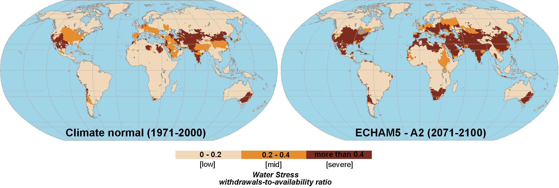
Harding R (2012) PAGES news 20(1): 38
Modified from Flörke M & Eisner S (2011) WATCH Technical report 46
Notes:
Water resources - How severe will freshwater resource shortages be on a regional scale?
Richard Harding
Centre for Ecology & Hydrology, Wallingford, UK; rjh@ceh.ac.uk
Figure 1: Water stress, calculated as the ratio between water withdrawals and availability, for the late 20th and 21st centuries (see Flörke and Eisner 2011).

Slide 33
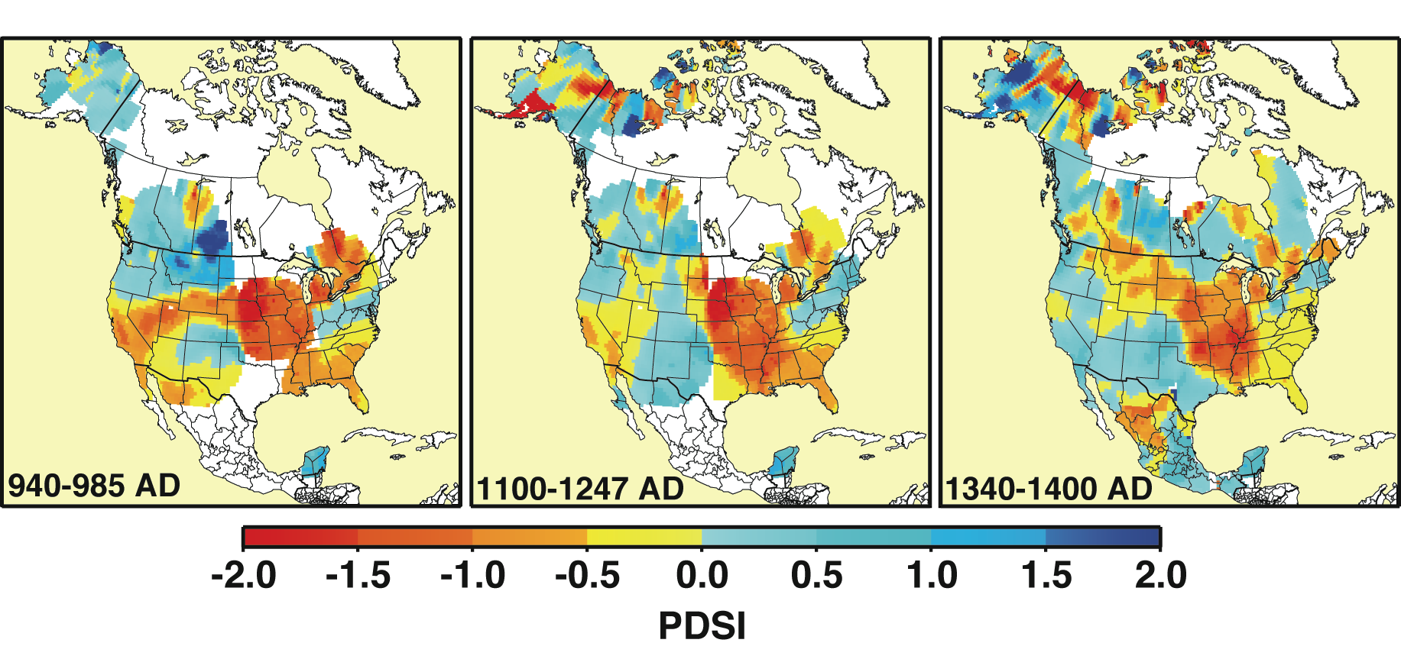
Cook ER (2012) PAGES news 20(1): 39
From Cook et al. (2010) Journal of Quaternary Science 25: 48-61
Notes:
Water resources - How severe will freshwater resource shortages be on a regional scale?
Edward R. Cook
Lamont-Doherty Earth Observatory, Columbia University, Palisades, USA; drdendro@ldeo.columbia.edu
Figure 1: Examples of three megadroughts reconstructed from tree rings that hit the central Mississippi Valley of the United States during early, middle, and late medieval times. See Cook et al. (2010b) for details. Reprinted with permission from Wiley & Sons.

Slide 34
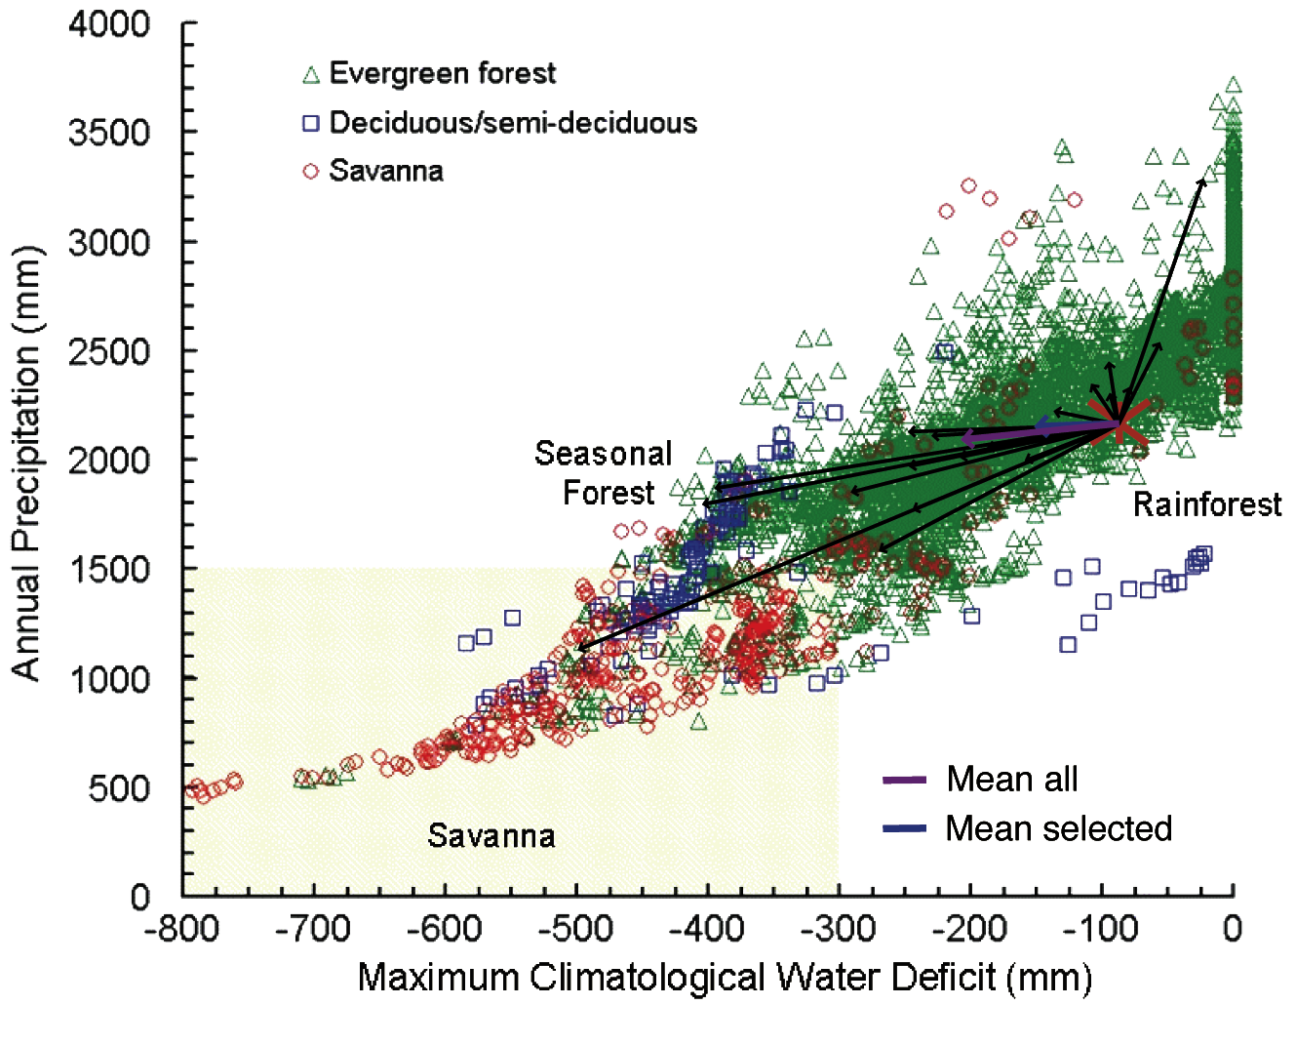
Lavorel S (2012) PAGES news 20(1): 40
Modified from Mahli Y et al. (2009) PNAS 106: 20610-20615
Notes:
Ecosystems - How do ecosystems and associated services respond to climatic change?
Sandra Lavorel
Laboratoire d’Écologie Alpine, CNRS, Université Joseph Fourier, Grenobles, France; Sandra.Lavorel@ujf-grenoble.fr
Figure 1: Type of vegetation in relation to rainfall in the Amazon region. The overlaid arrows show the trajectories of change as simulated by the 19 general circulation models used in the IPCC AR4 forced to start from the averaged observed climate over the period 1970-1999 AD (red star). The tips of the arrows represent the simulated late 21st century (2070-2099 AD) rainfall regime. The purple arrow shows the mean of all model trajectories and the blue arrow the mean of all models that simulate the late 20th century adequately. Figure modified from Mahli et al. (2009).

Slide 35
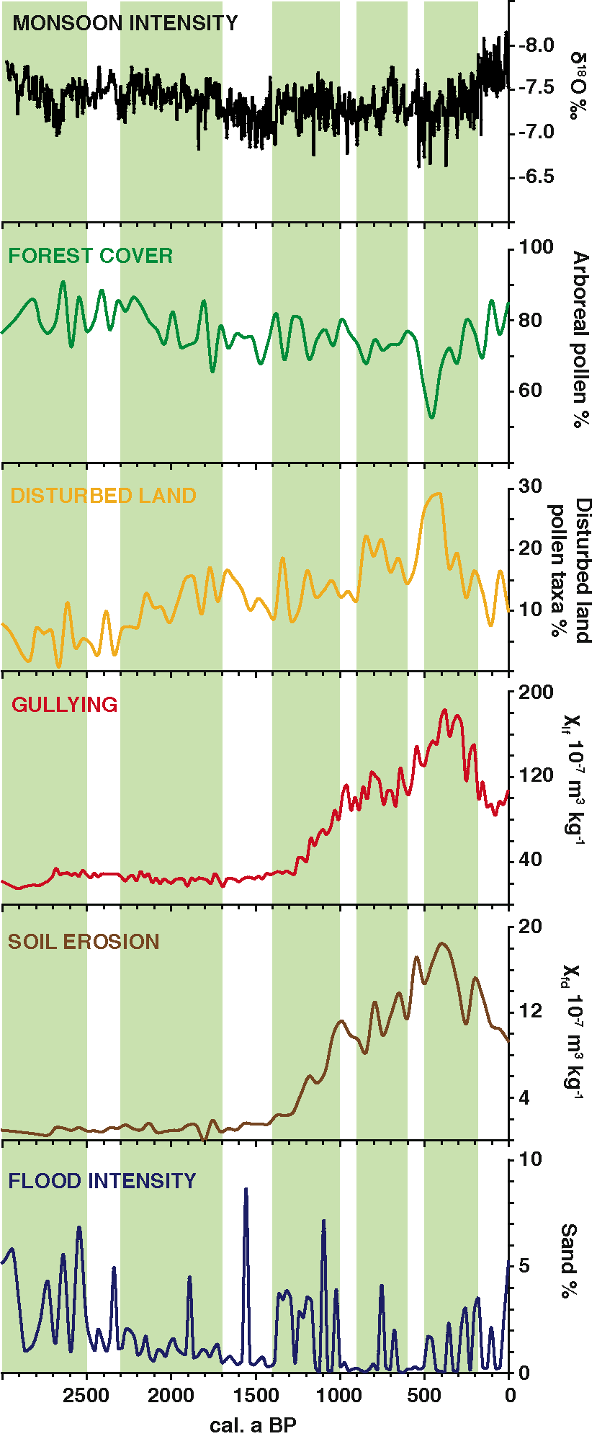
Jackson ST (2012) PAGES news 20(1): 41
From Dearing (2008) The Holocene 18: 117-127
Notes:
Ecosystems - How do ecosystems and associated services respond to climatic change?
Stephen T. Jackson
Department of Botany and Program in Ecology, University of Wyoming, Laramie, USA; Jackson@uwyo.edu
Figure 1: Geohistorical records of temporal changes in ecosystem properties and services. This 3000-year composite record of regional ecosystem attributes (land cover, erosion, flood intensity) inferred from sediments of Lake Erhai and monsoon intensity inferred from a speleothem shows ecosystem responses to changes in human population, cultural practices, and climate. The five green bands show primary periods of human effects on the regional environment (left to right): Bronze-Age culture, Han irrigated period, Nanzhao Kingdom, Dali Kingdom, and late Ming/early Qing environmental crisis. (From Dearing 2008).

Slide 36
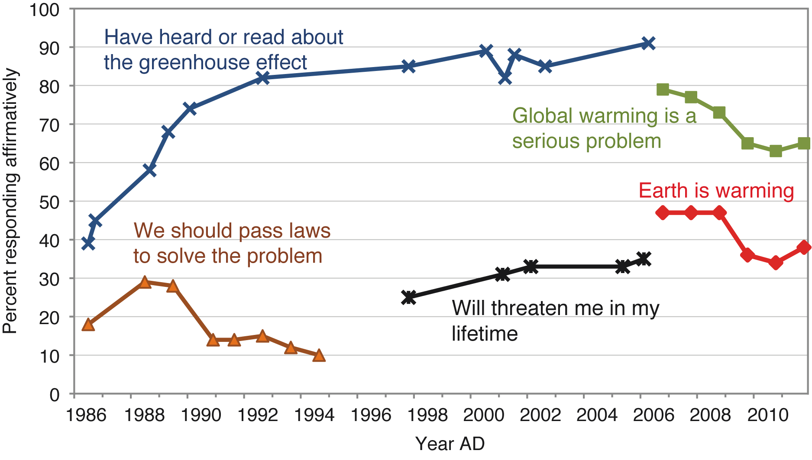
Lemoine D (2012) PAGES news 20(1): 42
Notes:
Abrupt changes - To what extent are tipping points a concern in coping with global change?
Derek Lemoine
Department of Economics, The University of Arizona, Tucson, USA; dlemoine@email.arizona.edu
Figure 1: The response of the U.S. public to surveys’ questions about global climate change (Pew Research Center for the People & the Press; Nisbet and Myers 2007).

Slide 37
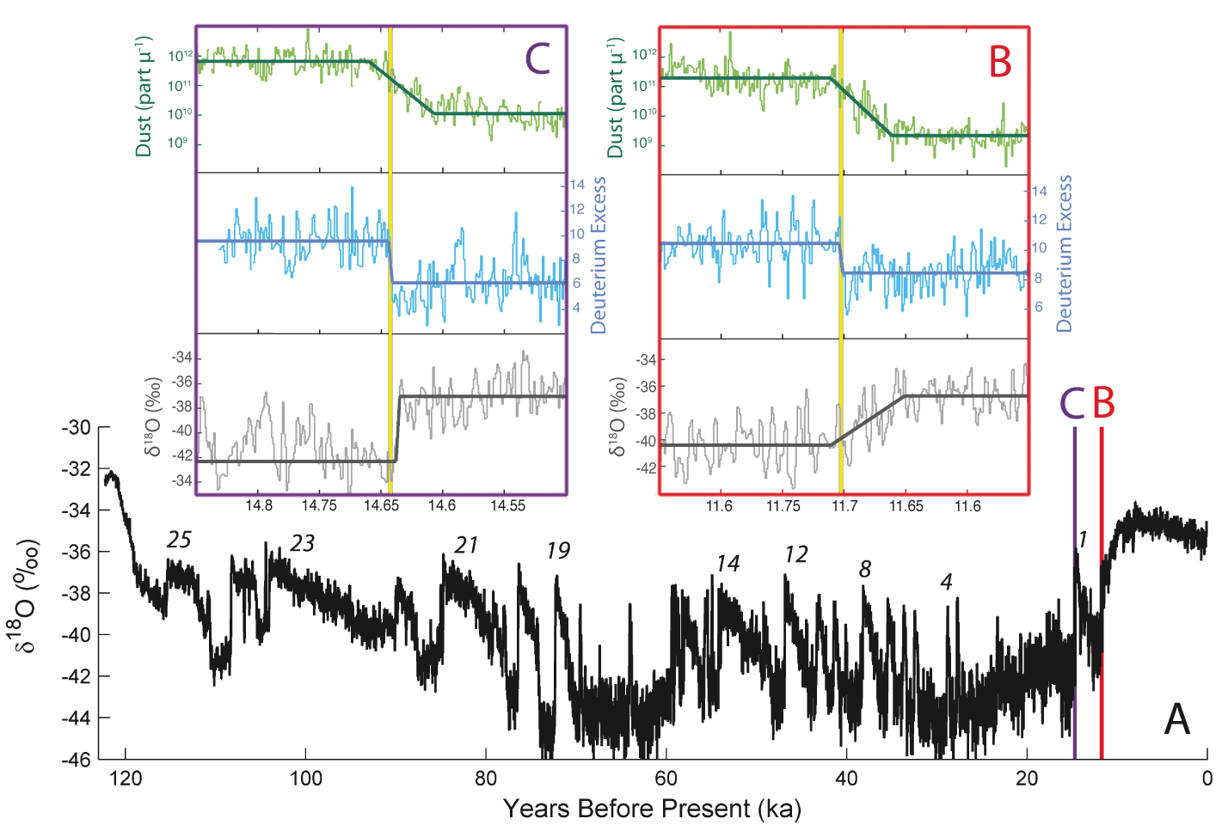
Dahl-Jensen D (2012) PAGES news 20(1): 43
Based on Steffensen et al. (2008) Science 321: 680-684
Notes:
Abrupt changes - To what extent are tipping points a concern in coping with global change?
Dorthe Dahl-Jensen
Niels Bohr Institute, University of Copenhagen, Denmark; ddj@gfy.ku.dk
Figure 1: High-resolution records from the Greenland ice core NGRIP. Panel A shows stable water isotopes (δ¹⁸O) in 20-year resolution. Numbers mark the most prominent of the 25 Dansgaard-Oeschger events. Panels B and C zoom in on two 300-year intervals during the transition from the last glacial to the Holocene. Shown are records of δ¹⁸O, deuterium excess and the unsolvable dust at 1-year resolution. The solid lines highlight the transitions in the records; the vertical yellow lines mark the steps in deuterium excess over just a few years. (Figure based on Steffensen et al. 2008).

Slide 38
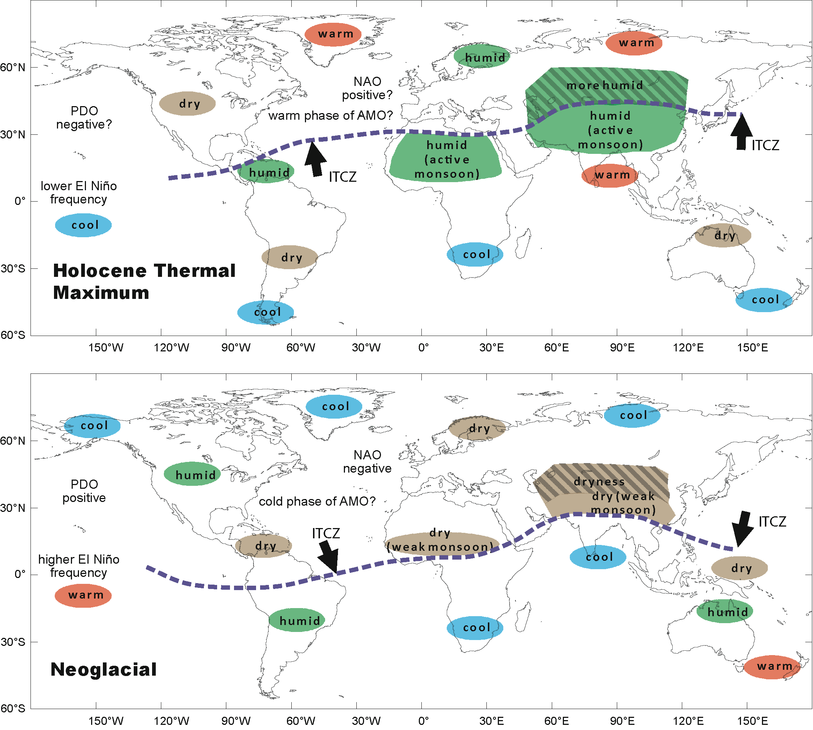
Wanner H & Brönnimann S (2012) PAGES news 20(1): 44-45
Notes:
Is there a global Holocene climate mode?
Heinz Wanner^{1,2} and Stefan Brönnimann^{1,2}
¹Institute of Geography, University of Bern, Switzerland; wanner@oeschger.unibe.ch
²Oeschger Centre for Climate Change Research, University of Bern, Switzerland
Figure 1: Climate patterns of the Holocene Thermal Maximum (~7-4.5 ka BP; Ljungqvist 2011), and the Neoglacial, which started around 4.2 ka BP and ended with the modern industrialization in the 19th century. Both Figures were outlined based on existing Holocene proxy time series (Wanner et al. 2011).

Slide 39
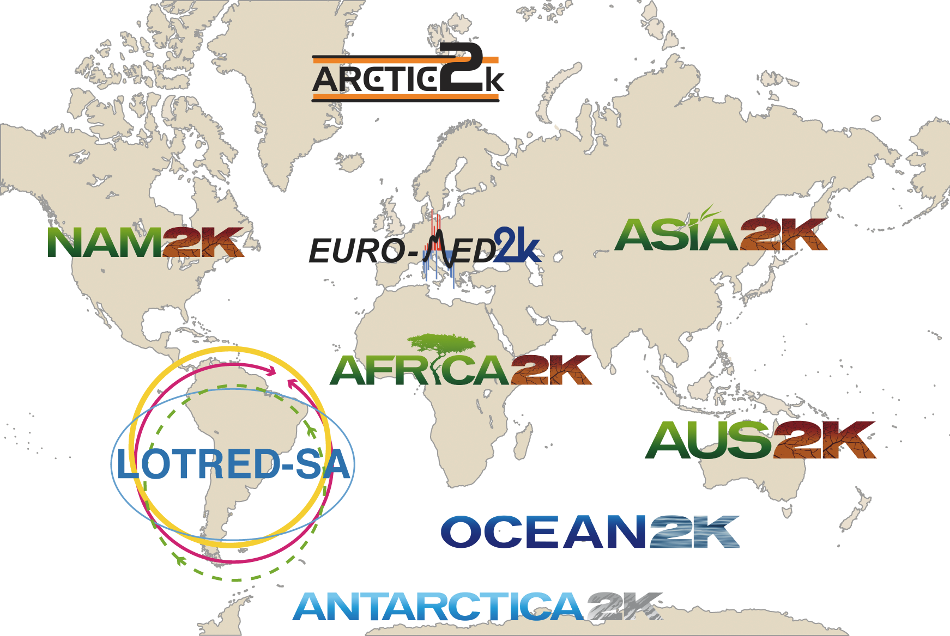
von Gunten et al. (2012) PAGES news 20(1): 46
Notes:
2nd PAGES 2k Network Meeting: Review of status and plans for Synthesis
Lucien von Gunten¹, H. Wanner² and T. Kiefer¹
¹PAGES-International Project Office, Bern, Switzerland
²Oeschger Center for Climate Change Research, University of Bern, Switzerland; wanner@oeschger.unibe.ch
Figure 1: The nine regional groups of the PAGES 2k Network on 2000-year climate reconstructions.

Slide 40
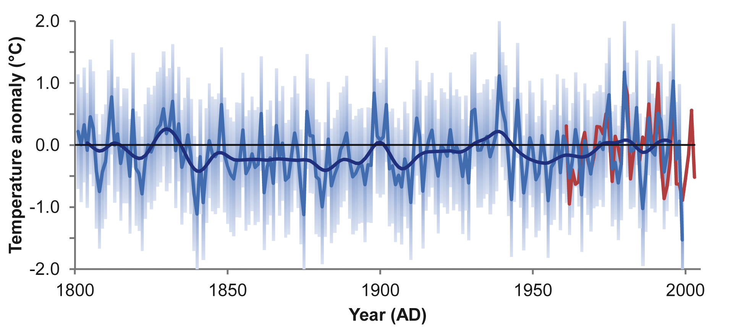
van Ommen et al. (2012) PAGES news 20(1): 47
Adapted from Schneider et al. 2006, Geophysical Research Letters 33
Notes:
1st Workshop of the PAGES Antarctica2k Working Group
Tas van Ommen¹ and the Antarctica2k Steering Committee
¹Australian Antarctic Division (AAD), Kingston, Australia; tas.van.ommen@aad.gov.au
Figure 1: Antarctic temperature reconstruction from AD 1800-2000 based on five ice core sites (adapted from Schneider et al. 2006). Blue curves are the annual reconstruction and a decadal smooth (Gaussian with σ=3 years). Error shading shows 95% confidence interval. Red curve is calibration temperature target. The zero reference is the 1961-1990 climatological mean.

Slide 41
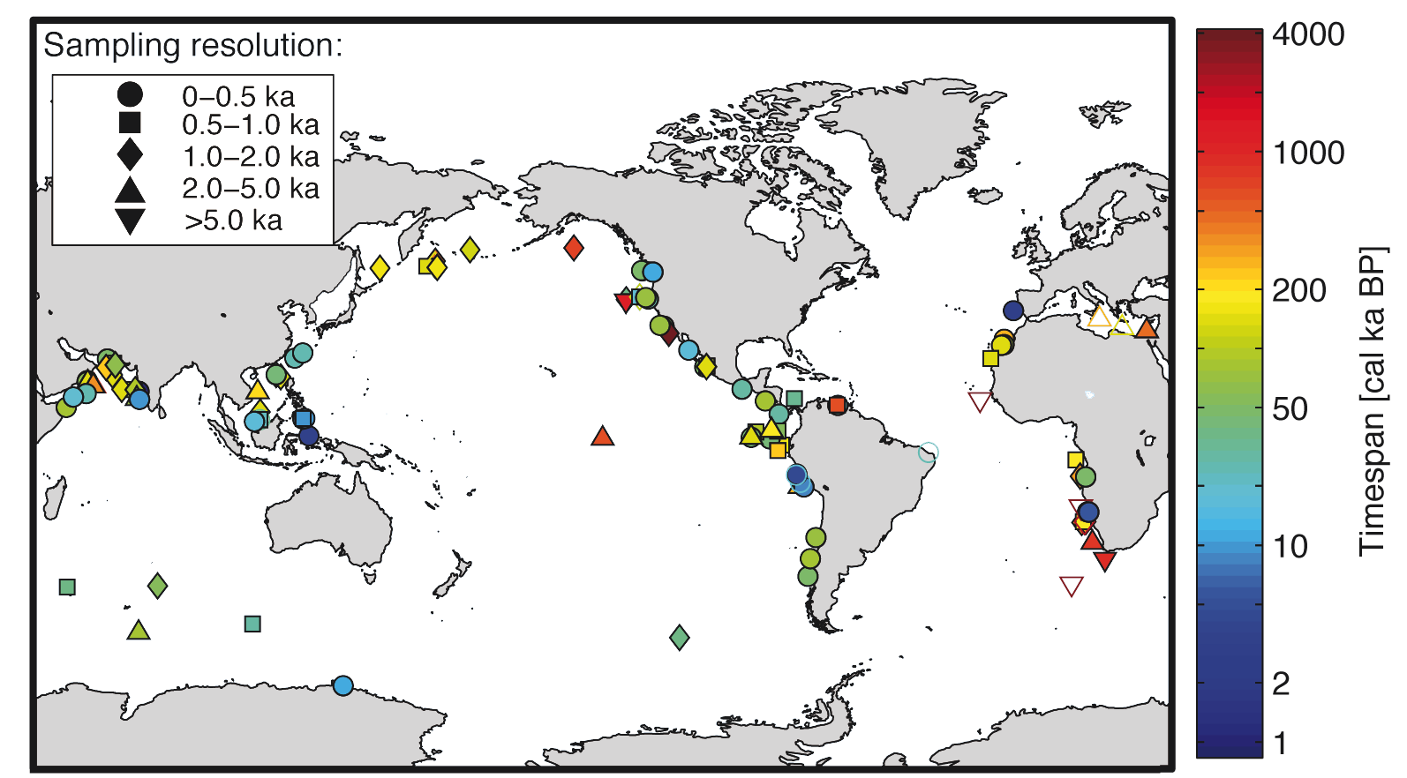
Rafter et al. (2012) PAGES news 20(1): 48
Notes:
The nitrogen cycle in the ocean, past and present
Patrick A. Rafter¹, S.L. Jaccard², E.D. Galbraith³, T. Kiefer⁴ and M. Kienast⁵
¹Department of Geosciences, Princeton University, Princeton, USA; prafter@princeton.edu
²Climate Geology, ETH Zurich, Switzerland; ³Earth & Planetary Sciences, McGill University, Montreal, Canada; ⁴PAGES International Project Office, Bern, Switzerland; ⁵Department of Oceanography, Dalhousie University, Halifax, Canada
Figure 1: Global distribution of available sedimentary δ¹⁵N records, together with their respective temporal coverage and resolution. Cores that do not cover the last glacial cycle are marked by an open symbol.

Slide 42
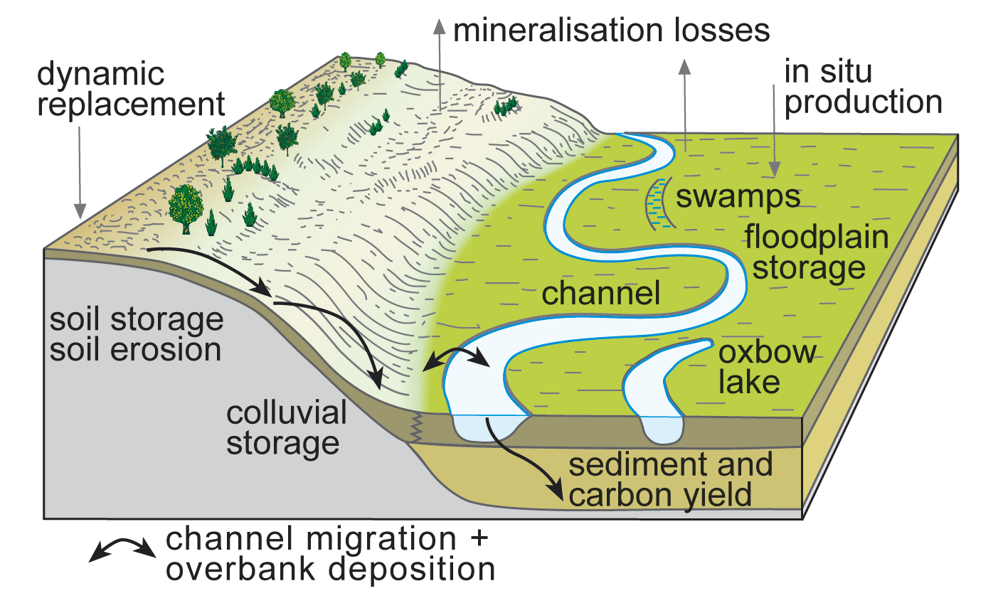
Hoffmann et al. (2012) PAGES news 20(1): 49
Notes:
Open PHAROS workshop on “Sediment and carbon fluxes under human impact and climate change”
Thomas Hoffmann¹, G. Erkens², G. Verstraeten³, H. Middelkoop² and A. Lang⁴
¹Department of Geography, University of Bonn, Germany; thomas.hoffmann@uni-bonn.de
²Department of Physical Geography, Utrecht University, The Netherlands; ³Division of Geography, University Leuven, Belgium; ⁴School of Environmental Science, University of Liverpool, UK
Figure 1: Sediment-burden carbon fluxes on hillslopes and in floodplains; representing key mechanisms as mentioned in the text.

Slide 43
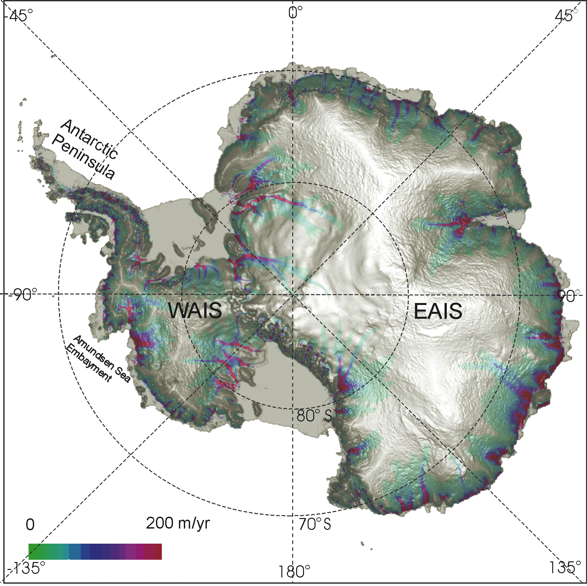
Siddall et al. (2012) PAGES news 20(1): 50
From Bamber et al. (2007) Earth and Planetary Science
Letters 257: 1-13
Notes:
Ice sheet modeling, sea level and Isostasy
Mark Siddall¹, Peter Huybers² and Jerry X. Mitrovica²
¹Department of Earth Sciences, University of Bristol, UK; mark.siddall@bristol.ac.uk
²Department of Earth and Planetary Sciences, Harvard University, Cambridge, USA
Figure 1: Surface topography derived from satellite radar altimetry and steady-state ice flow rates for the Antarctic ice sheet for the present-day (Bamber et al. 2007). Reprinted with permission from Elsevier.

Slide 44
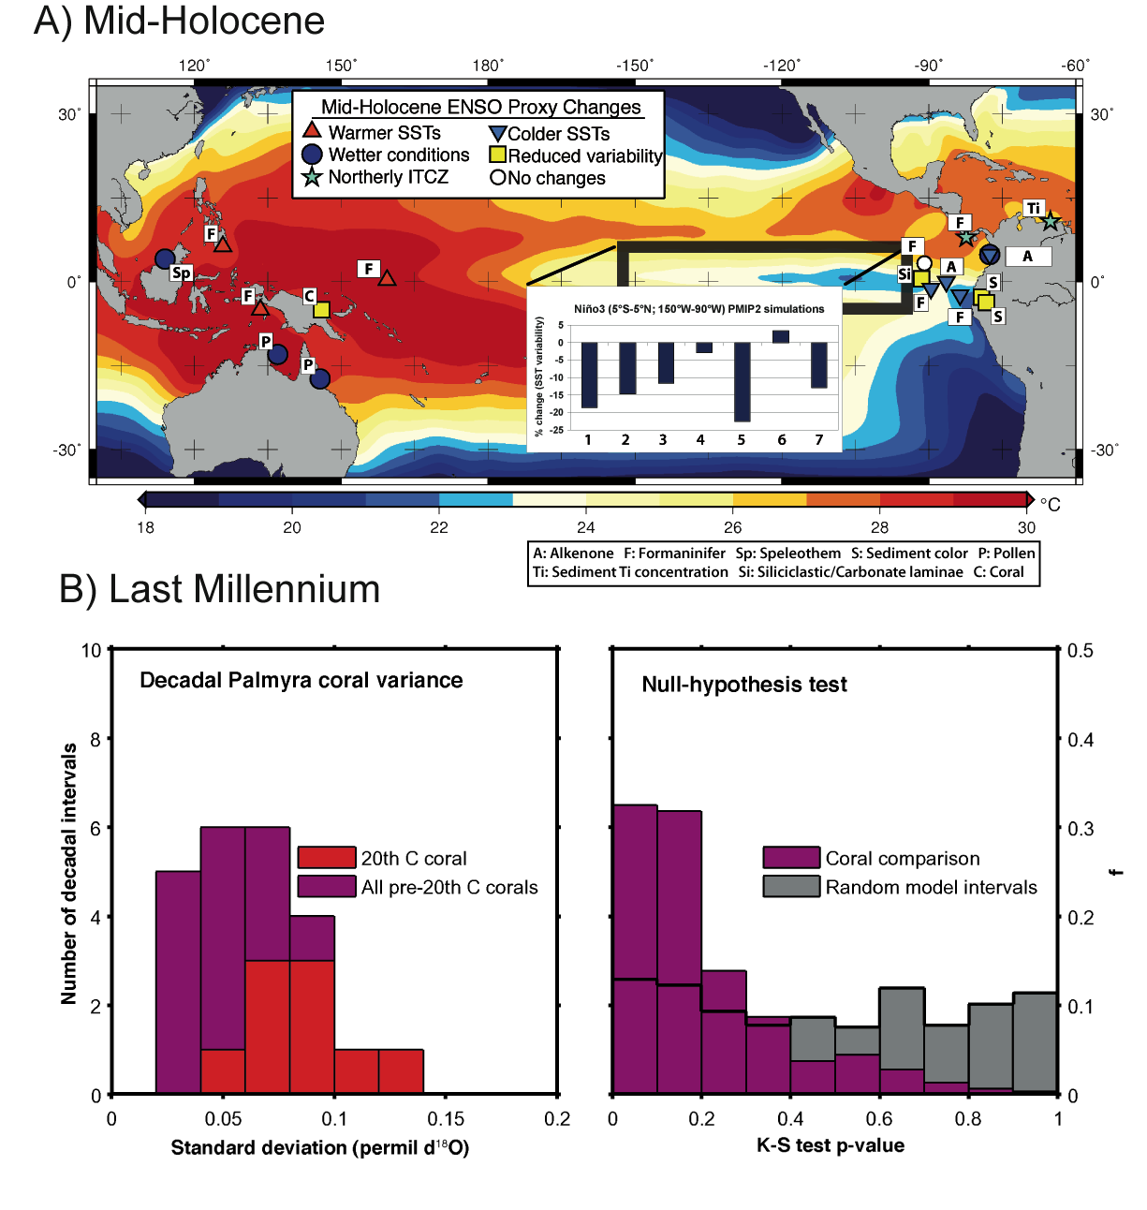
Braconnot et al. (2012) PAGES news 20(1): 51
Notes:
Tropical Climate Variability with a focus on Last Millennium, Mid-Holocene and Last Glacial Maximum
Pascale Braconnot¹, S.P. Harrison², S. Tudhope³ and C. Michaut⁴
¹Laboratoire des Sciences du Climat et de l’environnement, CEA-CNRS, Gif-Sur-Yvette, France; pascale.braconnot@lsce.ipsl.fr
²School of Biological Sciences, Macquarie University, North Ryde, Australia; ³Departement of Geology and Geophysics, University of Edinburgh, UK; ⁴Institut Pierre Simon Laplace, UVSQ, France
Figure 1: Analyses of ENSO and model-data comparison for the mid-Holocene and the Last Millennium. A) Map showing a synthesis of the Pacific state during the mid-Holocene (from Braconnot et al. 2011), together with the change in El-Nino variability (%) as simulated by PMIP2 simulations #1-7 (inset, Zheng et al. 2008). Coral data (Tudhope et al. 2001, “C”) indicate a 60% reduction in ENSO, suggesting that simulations underestimate the observed changes (Brown et al. 2008). The background shows SSTs during the La Nina event of December 1998. The results in (B) are from Russon et al. (unpublished data). Left panel: Distribution of decadal standard deviations of stable oxygen isotope records from modern and fossil corals (Cobb et al. 2003). Variance was relatively lower before than during the 20th century. Right panel: Kolmogorov-Smirnov test of the null hypothesis that the two probability density functions shown in the left panel are drawn from the same distribution. For the coral comparison (purple bars) p-values are generally <0.2, suggesting rejection of the null hypothesis, whereas an equivalent comparison of randomly sampled control run data of the HadCM3 climate model (gray bars) is consistent with the null hypothesis. Thus, the differences between the decadal variance properties of ENSO in the 20th Century and the pre-20th Century are likely to represent forced ENSO variability.

Slide 45
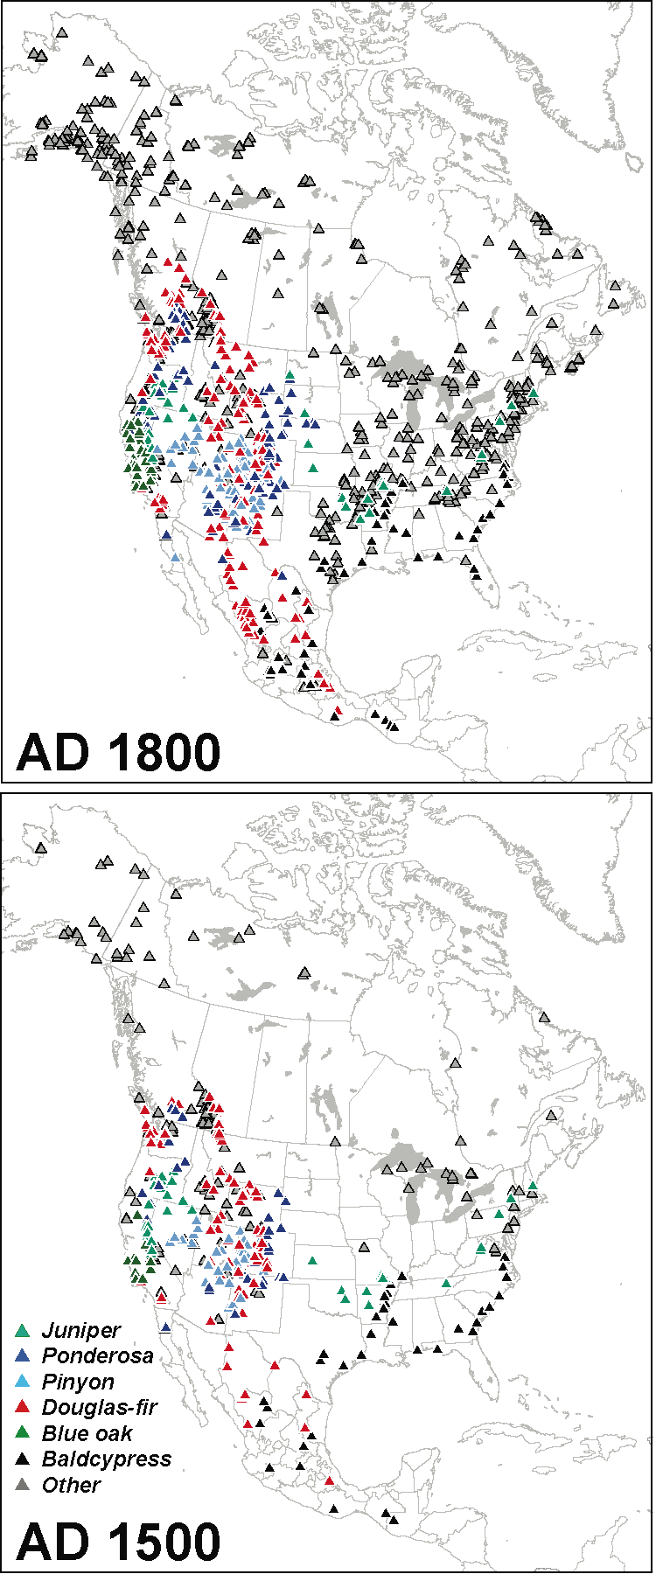
Trouet et al. (2012) PAGES news 20(1): 52
Notes:
North American Dendroclimatic Data: Compilation, Characterization, and Spatiotemporal Analysis
Valerie Trouet¹, D. Stahle² and H. Diaz³
¹Laboratory for Tree-Ring Research, University of Arizona, Tucson, USA; trouet@ltrr.arizona.edu
²Department of Geosciences, University of Arkansas, Fayetteville, USA; ³Cooperative Institute for Research in Environmental Sciences, University of Colorado, Boulder, USA
Figure 1: Species-specific tree-ring chronologies available for the North American continent that extend back to AD 1800 and AD 1500.

Slide 46
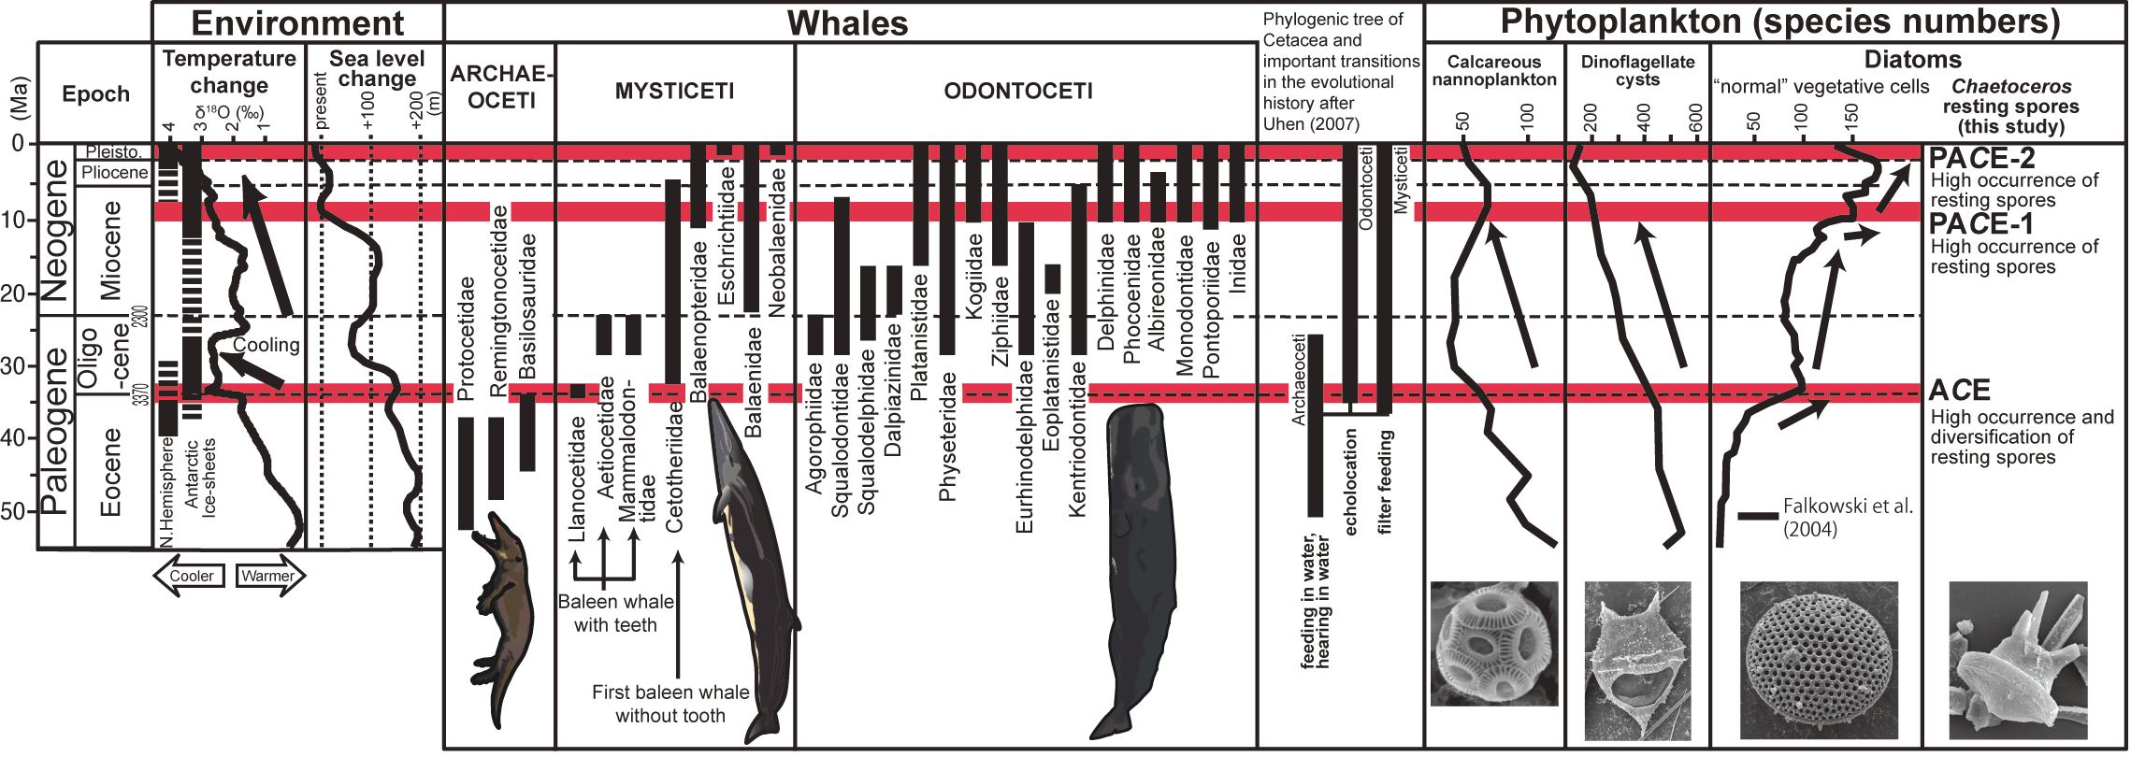
Leventer et al. (2012) PAGES news 20(1): 53
Notes:
3rd Polar Marine Diatom Taxonomy and Ecology Workshop
Amy Leventer¹, L. Armand², D. Harwood³ and R. Jordan⁴
¹Geology Department, Colgate University, Hamilton, USA; aleventer@colgate.edu
²Department of Biological Sciences, Macquarie University, Sydney, Australia; ³Department of Earth & Atmospheric
Figure 1: Comparison of marine phytoplankton species-richness curve indicated by Falkowski et al. (2004) with chronologic ranges of cetacean families worldwide by Uhen (2007), and sea-level change. Global deep-sea oxygen record and paleo-temperature change are by Zachos et al. (2001) and the presence data of sea ice and ice sheets were compiled by St. John (2008) and Stickley et al. (2009). The Atlantic Chaetoceros Explosion (ACE) event occurred across the E/O boundary in the North Atlantic, and is characterized by resting spore diversification that occurred as a consequence of upwelling activation following changes in thermohaline circulation through global cooling in early Oligocene. Pacific Chaetoceros Explosion events-1 and -2 (PACE-1 and PACE-2) are characterized by relatively higher occurrences of iron input following the Himalayan uplift and aridification at 8.5 Ma and ca. 2.5 Ma in the North Pacific regions. From Itsuki Suto, Nagoya University, Japan.

Slide 47
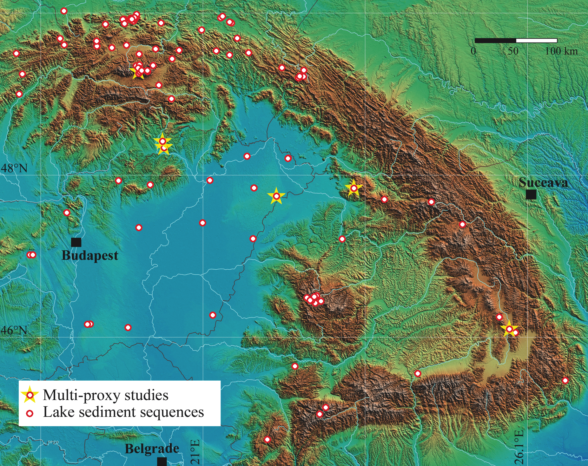
Mindrescu M (2012) PAGES news 20(1): 54
Modified from Buczkó et al. (2009) Hydrobiologia 631: 3-28
Notes:
Climate change in the Carpathian-Balkan region during the Late Pleistocene and Holocene
Marcel Mindrescu
Department of Geography, University of Suceava, Romania; marcel.mindrescu@gmail.com
Figure 1: Map showing all sedimentary sequences identified in the Carpathian mountain range by Buczkó et al. (2009) in their review of dated Late Quaternary paleolimnological records. Despite the relative density of records listed in that study, the authors conclude that only very few records can be used for modern environment or climate studies, and that large areas of the Carpathian mountains remain under-investigated. Figure modified from Buczkó et al. (2009).

Slide 48
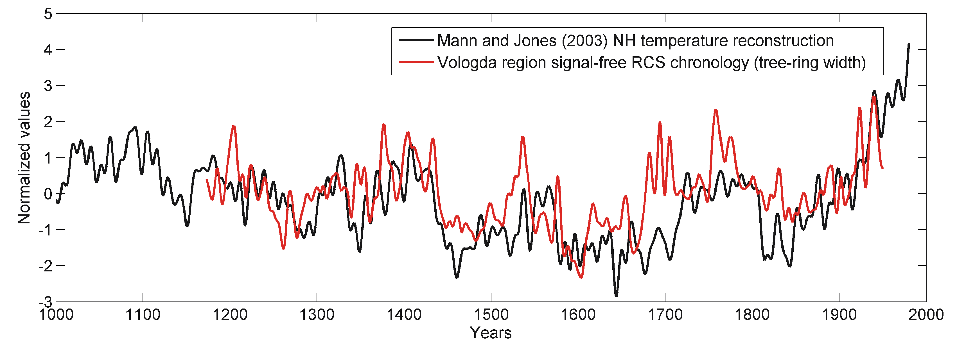
Bushueva I & Kurbanov R (2012) PAGES news 20(1): 55
Notes:
International conference of young scientists “Land-Ocean-Atmosphere Interactions in the Changing World”
Irina Bushueva and Rejep Kurbanov
Institute of Geography, Russian Academy of Sciences, Moscow, Russia; irinasbushueva@gmail.com
Figure 1: Comparison of Vologda region (60°N, 38°W) signal-free Regional Curve Standardization (RCS) tree-ring width chronology (red) with the Mann and Jones (2003) northern Hemisphere (NH) temperature reconstruction (black) (Correlation R=0.59). The Little Ice Age is well pronounced during 1450-1660 AD.

